Slide 1
Moving from Welfare to Work: Jobless Households and the Quality of Supportive Services
Helen Johnston & Anne-Marie McGauran

Slide 2
Outline of Presentation
Why focus on jobless households?
About the NESC Study
Experience of household joblessness
Findings – the key themes
Engagement with employment support services
Employment opportunities
Moving from welfare to work
Education and training
The role of institutions in service provision
Conclusions
Notes:
Ok, that was a quick overview of the people we talked to a part of a jobless household study my colleague Anne-Marie McGauran and myself have undertaken over the last year and a half, and which I am going to talk about today.
This is an outline of what I am going to talk about today.

Slide 3
Why focus on jobless households
Household joblessness is high in Ireland
People in jobless households have a high risk of poverty
Household joblessness has a long and lasting impact on children
Household joblessness is a significant cost to the state
Jobless households are households where no-one is working or there is only marginal attachment to the labour force (sometimes referred to as low work intensity households)
Notes:
Ok, that was a quick overview of the people we talked to a part of a jobless household study my colleague Anne-Marie McGauran and myself have undertaken over the last year and a half, and which I am going to talk about today.
This is an outline of what I am going to talk about today.

Slide 4
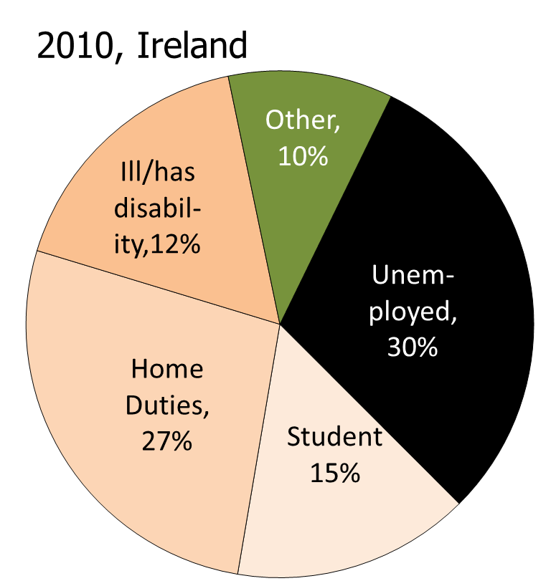
Household Joblessness is distinct from Unemployment
Broader than unemployment
Includes caring for home & family, people with disability, carers, lone parents
Considers all the adults under 60 in a household
Notes:
The first point to make is that household joblessness is distinct from unemployment.
Jobless households are where no-one in the household is working or is working very few hours, sometimes referred to a very low work intensity.
The main point to make that household joblessness is broader than unemployment and includes caring for home and family, people with disability, carers and lone parents, as illustrated in this pie chart which is taken from a study by the ESRI. Even though the data are now a bit dated you can see that people who are officially unemployed only make up about one third of those in jobless households.
So, household joblessness considers the total household context, rather than just the individual, and takes into consideration the distribution of work across households (work-rich; work-poor).

Slide 5
NESC Study: in a Disadvantaged Suburb of Dublin
92 Interviews with:
The area had characteristics of jobless households, which are:
33 jobless households (34 people)
16 local services
11 county/regional services
11 local employers
12 government departments / agencies
9 national stakeholders
Higher levels of unemployment
Lower education levels
Higher rates of disability
Households more likely to contain children
More likely to be headed by a lone parent
More likely to be in the manual social class
More likely to be renting accommodation
Notes:
We have been undertaking our study in a disadvantaged suburb of Dublin where there is an interest, through the Local Community Development Committee, in addressing household joblessness.
We undertook a total of 93 interviews.
We were anxious to talk to a range of different types of household, mainly with children, and we interviewed 33 – 2 parent households, lone parent households, households containing people with a disability, and with carers, non-Irish nationals, mainly Africans, Travellers and households who were living in emergency accommodation, as well as 2 people who were single.
We accessed our interviewees through community centres and organisations working in the area, as well as through the distribution of flyers in local community centres, social welfare and employment officers, the library, credit union, St Vincent de Paul etc.
When we had analysed the household interviews we then carried out 16 interviews with front-line providers, based on organisations the interviewees had told us they interacted with – read out the list.
We also interviewed 11 employers, again based on the type of work interviewees told us they were looking for – read out the list
And so on – read out info from the slide
Essentially this provided what we refer to as a 360 degree perspective.

Slide 6
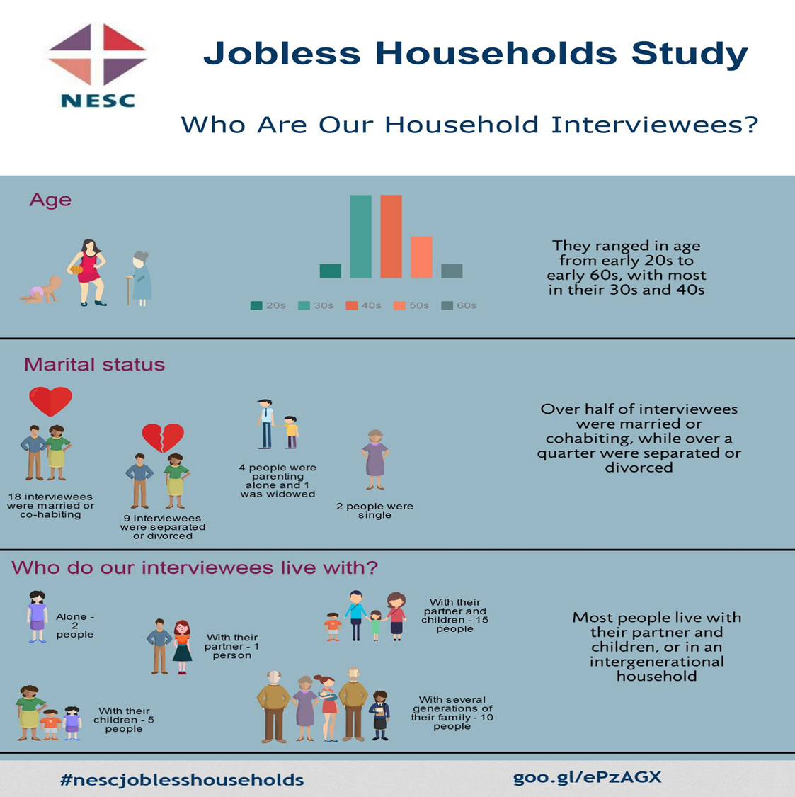

Slide 7


Description of Household Interviewees
Education Levels
Housing
No formal qualifications – 9
Junior certificate - 2
Leaving certificate – 4
Apprenticeship – 3
FETAC level 5/6 – 4
Degree – 4
Literacy difficulties/dyslexia – 7
All attached high value to education
Own home – 7 (6 in mortgage arrears)
Council house – 11
Emergency accommodation – 3
Sharing with relatives – 10

Slide 8


Description of Household Interviewees
Labour market experience
None – 5 – refugees, Travellers, young people
Low skilled jobs – 20
Medium skilled jobs – 10
High skilled jobs – 8
4 moved from low skill to high skill
4 (all African migrants) moved from high skill to low skill
Reasons for unemployment
The economic crash – 10
Having a family – 7 (all women)
Ill health of self/family member – 6
Other factors, including discrimination – 7 (Travellers/African migrants)
Rent supplement rules – 2
More than 1 reason - 17
Notes:
In this slide I provide an overview of the key findings.
We interviewed one person in each household, but asked about the household context. We are still undertaking analysis of the service managers, government department and public agency and other national stakeholders interviews, so this part is not yet fully complete.
First of all, nearly everyone we interviewed had worked at some stage in their lives, and often they had worked for many years. The exceptions was an early school leaver, a refugee and the Travellers we interviewed.
20 of them had worked in low skill jobs such as cleaning, labouring, shop work, catering, security while 10 had worked in medium skilled jobs such as office work, supervisory work, or in a trade. A few people had progressed in their careers while others, the migrants, had taken jobs in Ireland below their level of qualification and experience.
The Interviewees had below average levels of education when compared with the population of Dublin overall, with a number of people having very low levels of literacy, or dyslexia or difficulties with the English language.
One third of those we interviewed had become unemployed due to the economic crash. Having a family was the reason why several women had left employment, particularly the older women and lone parents. Illness of a person who was working or someone in their family was another reason for leaving employment. Other reasons for being unemployed included lack of work experience or literacy difficulties.

Slide 9
Social Welfare Payments and Job Search
Payment Type
Job Search
* Qualified adult = the adult dependent of a person receiving a social welfare payment
Notes:
So, on to the main findings. First we look at transitioning from welfare to work.
If we look first at payment type, we see that, as expected, the majority are on a jobseekers payment. But also notable, is the range of payments people are on – 4 are on an unemployment scheme, 4 are on a disability or invalidity payment and 3 are on a carers payment. 3 are on a lone parents or Jobseekers Transition payment and 2 were qualified adults – which brought its own limitations for these people.
We asked interviewees about their job search activities – point out main quadrants from the pie chart, referring to the colour segments.

Slide 10
Key Findings – Households – Positive Aspects
The vast majority wanted a paid job
Benefits of some education and training courses
The value of employment support schemes
The benefits of living in local authority housing
The support of family and friends, and the wider community
The value of volunteering
Resilience, ambition, hope were evident in many interviewees
Notes:
While I will go on to talk about some of the barriers for jobless households in getting a job I first of all want to high some positive aspects.
The vast majority of the interviewees we spoke to want to get a paid job. For some this is any job, while for others they wanted something local or that they could work around their family commitments, while others wanted jobs in areas that they were qualified in or had trained in.
All of the interviewees we spoke to had been on courses. Some, but not all, had found them to be useful in getting a qualification or a skill which they hoped would help them find a job.
Many people, but again not all, reported getting help and support from their case officers in Intreo or in employment services or in other services eg. community centres, MABs, Citizens Information etc which they hoped would help them find a job or the services that they required.
A number of people had been on or were on employment support schemes. Most people found these beneficial as people liked getting out of the house and having something to do, although some people did think that the scheme had not led them anywhere and that they were being exploited. (same points for volunteering)
Those people living in local authority housing felt much more secure in terms of looking for work than those who living in various precarious housing situations – council housing seems to bring stability to some of these households.
Many of the households referred to support from family and friends, and indeed the wider community. This related to help with child minding, housing with many people living with family or friends, plus financial support and loans, as well as moral support.
Many people volunteered in their local community and were on local committees. People said this got them out of the house and helped them feel they were making a contribution. However, even though volunteer experience was valued by employers such experience did not necessarily lead to people getting a paid job.
Despite harrowing circumstances of dealing with trauma, addiction, debt and unemployment many of these people showed high levels of resilience, ambition and hope that things would get better. Most people had high levels of ambition for their children, especially in relation to their education and subsequent ability to get a job.

Slide 11



Key Themes Engagement with Employment Support Services
Three key services -
Changes since 2012:
Engagement with jobless households:
Changes since 2012:
Activation
Intreo case officers who try to find ‘clients’ training or job opportunities
Personal progression plans (PPPs) agreed between the ‘client’ and the case officer
But not everyone aware of PPPs
Sanctions for not engaging with activation
Low rate of application of sanctions
But threat of application felt
Can help promote engagement
Engagement:
Eligibility
Criteria vary
Qualified adults & some NEETS* usually not eligible for activation supports
Information
Complex system to understand
Jobseekers can be fearful to engage with Intreo in case their payment is cut
Depth of Engagement
Is it speed dating rather than in-depth career advice?
Are clients met ‘where they’re at’?
* NEETS = Young people not in employment, education or training
Activation
Case officers
Personal progression plans
But not everyone aware of these
Sanctions
Low rate of application
But threat of application felt
Can help promote engagement
Eligibility
Criteria vary
Qualified adults & some NEETS usually not eligible for activation supports
Information
Complex system to understand
Jobseekers can be fearful to engage with Intreo in case their payment is cut
Depth of Engagement
Is it speed dating rather than in-depth career advice?
Are clients met ‘where they’re at’?
Notes:
Some people had good positive relationships, whereas others had negative experiences. Seemed to depend on the ethos of the office, the nature of the engagement, and the capacity of the office in general and the case officer, in particular, as well as the attitude and expectations of the client.
Lots of rules – myriad of possibilities for the person, their family, and for the service providers. Only those on the live register have been actively engaged with so QAs, LPs and people with disabilities or caring responsibilities often have limited engagement.
People often had limited time with the case officer – this varied, but one interviewee referred to this process as ‘speed dating’.
There were mixed views on the value of sanctions. Some people found correspondence from the Department which mentioned sanctions threatening. Others saw the value in sanctions – both the households and service providers, in terms of getting people to engage, young people in particular, but others thought they could be damaging for the person and engagement with the service. However, in practice the use of sanctions was fairly limited, with payments being sent to another post office in the first instance!
Trust came up again and again. Even within the various services the nature of relationships varied. The level of trust often reflects the value systems within the various organisations and how the services are managed. Once broken it can be difficult to rebuild that trust.
In undertaking the interviews we provided some service providers with hypothetical cases and asked for their response. Not surprisingly perhaps there were some similarities, but also some differences in how the various service providers responded. I’ll just give you a couple of examples.
Read out the examples.

Slide 12
Key Themes Engagement of Employment Support Services with Employers
Strongest by , weakest by
Issues around data that can be shared with employers, and speed of responsiveness
Not all training providers engaged comprehensively with employers
Notes:
Some people had good positive relationships, whereas others had negative experiences. Seemed to depend on the ethos of the office, the nature of the engagement, and the capacity of the office in general and the case officer, in particular, as well as the attitude and expectations of the client.
Lots of rules – myriad of possibilities for the person, their family, and for the service providers. Only those on the live register have been actively engaged with so QAs, LPs and people with disabilities or caring responsibilities often have limited engagement.
People often had limited time with the case officer – this varied, but one interviewee referred to this process as ‘speed dating’.
There were mixed views on the value of sanctions. Some people found correspondence from the Department which mentioned sanctions threatening. Others saw the value in sanctions – both the households and service providers, in terms of getting people to engage, young people in particular, but others thought they could be damaging for the person and engagement with the service. However, in practice the use of sanctions was fairly limited, with payments being sent to another post office in the first instance!
Trust came up again and again. Even within the various services the nature of relationships varied. The level of trust often reflects the value systems within the various organisations and how the services are managed. Once broken it can be difficult to rebuild that trust.
In undertaking the interviews we provided some service providers with hypothetical cases and asked for their response. Not surprisingly perhaps there were some similarities, but also some differences in how the various service providers responded. I’ll just give you a couple of examples.
Read out the examples.

Slide 13
Key Themes Employment Opportunities
Types of employees sought:
Recruitment processes:
Motivated, good work ethic, good inter-personal skills
Particular qualifications were sometimes sought
Diverse and changing, ranging from online to word-of-mouth
Dropping in CVs not effective
Those with poor IT skills/access not well equipped for online recruitment
Notes:
Some people had good positive relationships, whereas others had negative experiences. Seemed to depend on the ethos of the office, the nature of the engagement, and the capacity of the office in general and the case officer, in particular, as well as the attitude and expectations of the client.
Lots of rules – myriad of possibilities for the person, their family, and for the service providers. Only those on the live register have been actively engaged with so QAs, LPs and people with disabilities or caring responsibilities often have limited engagement.
People often had limited time with the case officer – this varied, but one interviewee referred to this process as ‘speed dating’.
There were mixed views on the value of sanctions. Some people found correspondence from the Department which mentioned sanctions threatening. Others saw the value in sanctions – both the households and service providers, in terms of getting people to engage, young people in particular, but others thought they could be damaging for the person and engagement with the service. However, in practice the use of sanctions was fairly limited, with payments being sent to another post office in the first instance!
Trust came up again and again. Even within the various services the nature of relationships varied. The level of trust often reflects the value systems within the various organisations and how the services are managed. Once broken it can be difficult to rebuild that trust.
In undertaking the interviews we provided some service providers with hypothetical cases and asked for their response. Not surprisingly perhaps there were some similarities, but also some differences in how the various service providers responded. I’ll just give you a couple of examples.
Read out the examples.

Slide 14
Key Themes Employment Issues
Flexible hours:
Self-employment:
Some sectors offered mainly flexible hours
This led to unpredictable pay, and was problematic for main household income earners
Combining irregular hours with FIS/Jobseekers Allowance was problematic for main income earners, & employers
Some interviewees had unsuccessfully tried to set up their own business
Most lacked the finance to do so
Some bogus self-employment
Notes:
Some people had good positive relationships, whereas others had negative experiences. Seemed to depend on the ethos of the office, the nature of the engagement, and the capacity of the office in general and the case officer, in particular, as well as the attitude and expectations of the client.
Lots of rules – myriad of possibilities for the person, their family, and for the service providers. Only those on the live register have been actively engaged with so QAs, LPs and people with disabilities or caring responsibilities often have limited engagement.
People often had limited time with the case officer – this varied, but one interviewee referred to this process as ‘speed dating’.
There were mixed views on the value of sanctions. Some people found correspondence from the Department which mentioned sanctions threatening. Others saw the value in sanctions – both the households and service providers, in terms of getting people to engage, young people in particular, but others thought they could be damaging for the person and engagement with the service. However, in practice the use of sanctions was fairly limited, with payments being sent to another post office in the first instance!
Trust came up again and again. Even within the various services the nature of relationships varied. The level of trust often reflects the value systems within the various organisations and how the services are managed. Once broken it can be difficult to rebuild that trust.
In undertaking the interviews we provided some service providers with hypothetical cases and asked for their response. Not surprisingly perhaps there were some similarities, but also some differences in how the various service providers responded. I’ll just give you a couple of examples.
Read out the examples.

Slide 15
Key Themes Moving from welfare to work (1)
Challenges
Some interviewees very far from the labour market
Literacy difficulties, discrimination, trauma, addiction
Some interviewees closer to the labour market but other issues
Lack of confidence or motivation
Mental health difficulties
Rules of payment
Difficult to find training/employment which is below the number of hours a welfare recipient is allowed to train/work per week
Extent to which income from work replaces welfare income
Minimum wage employment does not always cover the costs of a family with a number of dependents
This issue is aggravated when working hours are uncertain
Costs of housing, childcare and medical expenses a factor
Notes:
Some people had good positive relationships, whereas others had negative experiences. Seemed to depend on the ethos of the office, the nature of the engagement, and the capacity of the office in general and the case officer, in particular, as well as the attitude and expectations of the client.
Lots of rules – myriad of possibilities for the person, their family, and for the service providers. Only those on the live register have been actively engaged with so QAs, LPs and people with disabilities or caring responsibilities often have limited engagement.
People often had limited time with the case officer – this varied, but one interviewee referred to this process as ‘speed dating’.
There were mixed views on the value of sanctions. Some people found correspondence from the Department which mentioned sanctions threatening. Others saw the value in sanctions – both the households and service providers, in terms of getting people to engage, young people in particular, but others thought they could be damaging for the person and engagement with the service. However, in practice the use of sanctions was fairly limited, with payments being sent to another post office in the first instance!
Trust came up again and again. Even within the various services the nature of relationships varied. The level of trust often reflects the value systems within the various organisations and how the services are managed. Once broken it can be difficult to rebuild that trust.
In undertaking the interviews we provided some service providers with hypothetical cases and asked for their response. Not surprisingly perhaps there were some similarities, but also some differences in how the various service providers responded. I’ll just give you a couple of examples.
Read out the examples.

Slide 16
Key Themes Moving from welfare to work (2)
Housing
Cost of housing can be a barrier, especially those in private rented accommodation
HAP (Housing Assistance Payment) will help but supply of housing an issue
Childcare
Affordable, accessible childcare required
After-school care often not available; nor during school holidays
Medical costs
Costs of medical treatment an issue for some in taking up a job
Can retain medical card for up to 3 years but not everyone knows this
Longer access to a medical card may be required for chronic or recurring conditions
Transport & IT
Transport to jobs can be expensive on a low income
Lack of access to IT can limit people’s capacity to apply for jobs online, to take up training, and to connect to other online services
Notes:
Some people had good positive relationships, whereas others had negative experiences. Seemed to depend on the ethos of the office, the nature of the engagement, and the capacity of the office in general and the case officer, in particular, as well as the attitude and expectations of the client.
Lots of rules – myriad of possibilities for the person, their family, and for the service providers. Only those on the live register have been actively engaged with so QAs, LPs and people with disabilities or caring responsibilities often have limited engagement.
People often had limited time with the case officer – this varied, but one interviewee referred to this process as ‘speed dating’.
There were mixed views on the value of sanctions. Some people found correspondence from the Department which mentioned sanctions threatening. Others saw the value in sanctions – both the households and service providers, in terms of getting people to engage, young people in particular, but others thought they could be damaging for the person and engagement with the service. However, in practice the use of sanctions was fairly limited, with payments being sent to another post office in the first instance!
Trust came up again and again. Even within the various services the nature of relationships varied. The level of trust often reflects the value systems within the various organisations and how the services are managed. Once broken it can be difficult to rebuild that trust.
In undertaking the interviews we provided some service providers with hypothetical cases and asked for their response. Not surprisingly perhaps there were some similarities, but also some differences in how the various service providers responded. I’ll just give you a couple of examples.
Read out the examples.

Slide 17
Key Themes Moving from welfare to work (3)
Supports available to support the transition from welfare to work
Family Income Supplement (now Working Family Payment)
Back to Work Family Dividend
HAP (Housing Assistance Payment)
Affordable Childcare Scheme
Retention of the medical card for 3 years
Awareness of some of these supports low
Can be delays in processing applications
Uncertainty about final income can make people fearful of making the transition to come off welfare
Employment Support Programmes can help provide work experience
For example, CE, Tús, (JobBridge – now closed)
But not always well linked to employment opportunities
Notes:
Some people had good positive relationships, whereas others had negative experiences. Seemed to depend on the ethos of the office, the nature of the engagement, and the capacity of the office in general and the case officer, in particular, as well as the attitude and expectations of the client.
Lots of rules – myriad of possibilities for the person, their family, and for the service providers. Only those on the live register have been actively engaged with so QAs, LPs and people with disabilities or caring responsibilities often have limited engagement.
People often had limited time with the case officer – this varied, but one interviewee referred to this process as ‘speed dating’.
There were mixed views on the value of sanctions. Some people found correspondence from the Department which mentioned sanctions threatening. Others saw the value in sanctions – both the households and service providers, in terms of getting people to engage, young people in particular, but others thought they could be damaging for the person and engagement with the service. However, in practice the use of sanctions was fairly limited, with payments being sent to another post office in the first instance!
Trust came up again and again. Even within the various services the nature of relationships varied. The level of trust often reflects the value systems within the various organisations and how the services are managed. Once broken it can be difficult to rebuild that trust.
In undertaking the interviews we provided some service providers with hypothetical cases and asked for their response. Not surprisingly perhaps there were some similarities, but also some differences in how the various service providers responded. I’ll just give you a couple of examples.
Read out the examples.

Slide 18
Key Themes Education and Training (1)
Education
Low educational levels, and in some cases literacy difficulties, puts people at a disadvantage when competing for jobs
Early school leaving remains an issue in disadvantaged areas, related to
Lack of parental engagement and capacity
Overly strict school disciplinary policies (in a small number of schools)
Lack of role models among the teaching staff
Lack of support for mental health difficulties
Curriculum that some find difficult to engage with
Attraction of a job, even if low paid
Low status of further education and training (compared to higher education)
Rates of lifelong learning are low, particularly for low skilled
Notes:
Some people had good positive relationships, whereas others had negative experiences. Seemed to depend on the ethos of the office, the nature of the engagement, and the capacity of the office in general and the case officer, in particular, as well as the attitude and expectations of the client.
Lots of rules – myriad of possibilities for the person, their family, and for the service providers. Only those on the live register have been actively engaged with so QAs, LPs and people with disabilities or caring responsibilities often have limited engagement.
People often had limited time with the case officer – this varied, but one interviewee referred to this process as ‘speed dating’.
There were mixed views on the value of sanctions. Some people found correspondence from the Department which mentioned sanctions threatening. Others saw the value in sanctions – both the households and service providers, in terms of getting people to engage, young people in particular, but others thought they could be damaging for the person and engagement with the service. However, in practice the use of sanctions was fairly limited, with payments being sent to another post office in the first instance!
Trust came up again and again. Even within the various services the nature of relationships varied. The level of trust often reflects the value systems within the various organisations and how the services are managed. Once broken it can be difficult to rebuild that trust.
In undertaking the interviews we provided some service providers with hypothetical cases and asked for their response. Not surprisingly perhaps there were some similarities, but also some differences in how the various service providers responded. I’ll just give you a couple of examples.
Read out the examples.

Slide 19
Key Themes Education and Training (2)
Training
Training offered to nearly all jobseekers via Intreo
Complex eligibility criteria, so that some people who wish to do this training do not meet the criteria
Choice – some interviewees went on courses they expressed an interest in; others felt ‘sent’ on courses, i.e. they had to go or they could have their payment cut
Limited supports to help with the costs of attending some courses
Reports of not enough places on some sought after courses
Patchy career guidance availability
Notes:
Some people had good positive relationships, whereas others had negative experiences. Seemed to depend on the ethos of the office, the nature of the engagement, and the capacity of the office in general and the case officer, in particular, as well as the attitude and expectations of the client.
Lots of rules – myriad of possibilities for the person, their family, and for the service providers. Only those on the live register have been actively engaged with so QAs, LPs and people with disabilities or caring responsibilities often have limited engagement.
People often had limited time with the case officer – this varied, but one interviewee referred to this process as ‘speed dating’.
There were mixed views on the value of sanctions. Some people found correspondence from the Department which mentioned sanctions threatening. Others saw the value in sanctions – both the households and service providers, in terms of getting people to engage, young people in particular, but others thought they could be damaging for the person and engagement with the service. However, in practice the use of sanctions was fairly limited, with payments being sent to another post office in the first instance!
Trust came up again and again. Even within the various services the nature of relationships varied. The level of trust often reflects the value systems within the various organisations and how the services are managed. Once broken it can be difficult to rebuild that trust.
In undertaking the interviews we provided some service providers with hypothetical cases and asked for their response. Not surprisingly perhaps there were some similarities, but also some differences in how the various service providers responded. I’ll just give you a couple of examples.
Read out the examples.

Slide 20
Key Themes The Role of Institutions in Service Provision
Ethos
The ethos & values of an institution influence how it is perceived by those who engage with it
Trust needs to be built to ensure that people engage effectively with services
Supports which are tailored to people’s needs
Tailored supports are key to help more vulnerable groups to progress, e.g. Travellers, African migrants, lone parents, those with literacy difficulties, etc
Some new services are tailored to particular circumstances, such as Housing Assistance Payment, Affordable Childcare Scheme
Implementation & Co-ordination
Action Plans, consultation with service users, and good outcome measurement all assist implementation
Competitive tendering can reduce co-operation between services
Good co-ordination requires dedicated time, staff & funds; and buy-in from stakeholders
Funding is important, but must be used effectively for good outcomes
Notes:
Some people had good positive relationships, whereas others had negative experiences. Seemed to depend on the ethos of the office, the nature of the engagement, and the capacity of the office in general and the case officer, in particular, as well as the attitude and expectations of the client.
Lots of rules – myriad of possibilities for the person, their family, and for the service providers. Only those on the live register have been actively engaged with so QAs, LPs and people with disabilities or caring responsibilities often have limited engagement.
People often had limited time with the case officer – this varied, but one interviewee referred to this process as ‘speed dating’.
There were mixed views on the value of sanctions. Some people found correspondence from the Department which mentioned sanctions threatening. Others saw the value in sanctions – both the households and service providers, in terms of getting people to engage, young people in particular, but others thought they could be damaging for the person and engagement with the service. However, in practice the use of sanctions was fairly limited, with payments being sent to another post office in the first instance!
Trust came up again and again. Even within the various services the nature of relationships varied. The level of trust often reflects the value systems within the various organisations and how the services are managed. Once broken it can be difficult to rebuild that trust.
In undertaking the interviews we provided some service providers with hypothetical cases and asked for their response. Not surprisingly perhaps there were some similarities, but also some differences in how the various service providers responded. I’ll just give you a couple of examples.
Read out the examples.

Slide 21
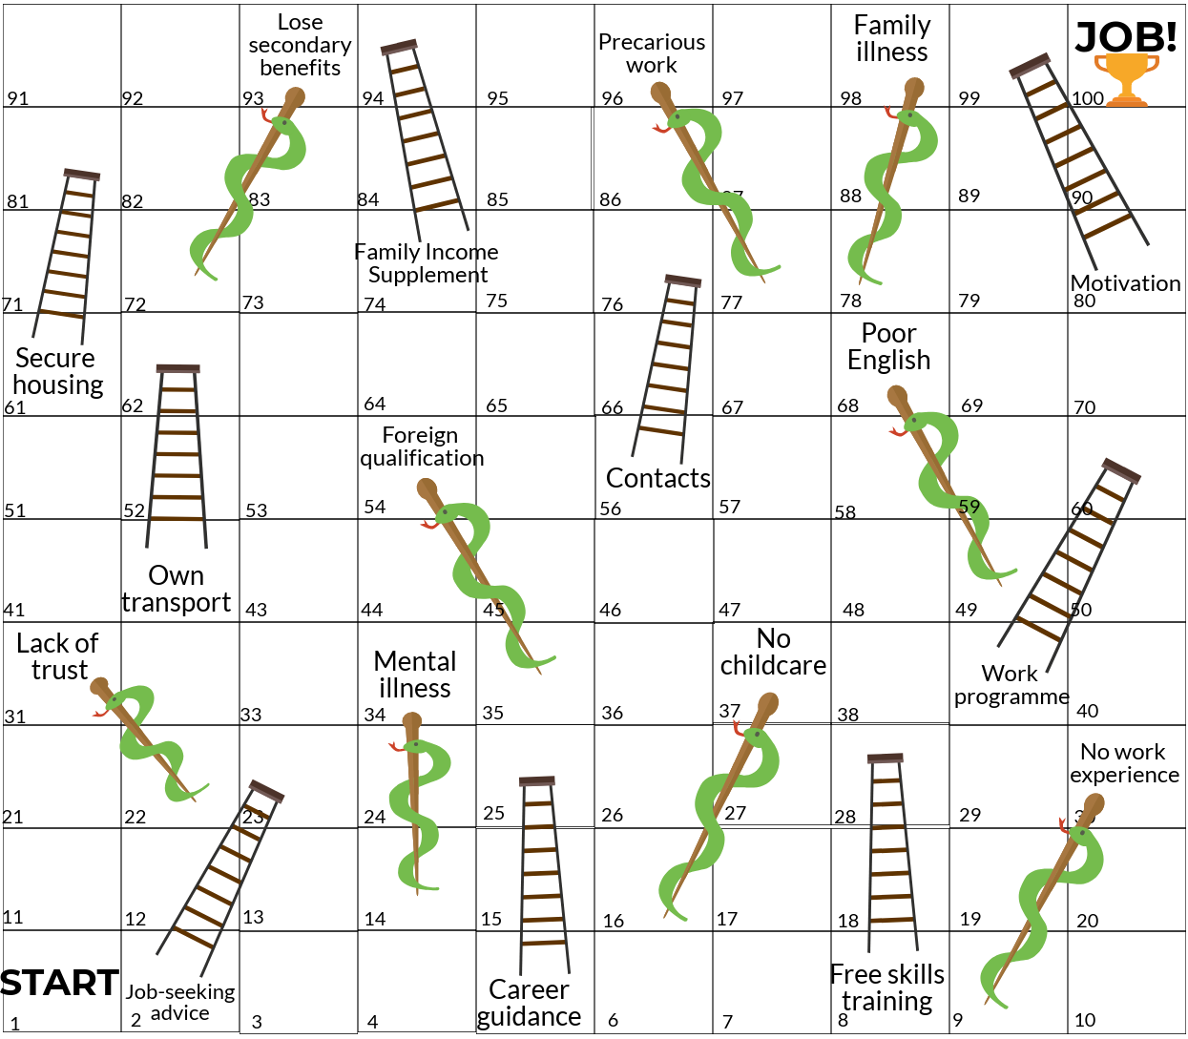
Key Barriers and Enablers in Transitioning from Welfare to Work

Slide 22
Conclusions – Key Messages (1)
The social welfare system and employment support system is generally supportive:
It keeps people out of income poverty
It tries to understand the needs of jobseekers
It is more benign than in some other countries
However:
There is a lack of trust in Intreo
People find it difficult to get information on the options open to them
At times, people feel they have no choice on activation/training options offered
It can be hard for vulnerable jobseekers to engage
Better feedback measures are needed
Notes:
Does work pay – range of factors related to the person, their circumstances (skills, number of children, family responsibilities, health), and jobs available. The Department has a Benefit of Work Ready Reckoner, which will show the benefit of working for many people but for someone with a partner, a number of children and on housing allowance who takes a job at the minimum wage it does not pay to take a job. However, we did find some people who would be prepared to take such a job to get them out of the house, plus the opportunity to move to a better paid job. This did not always work out in practice, as we heard from some of the people we spoke to.
FIS good if eligible and get it – but many issues in relation to its assessment, including links with employers, paperwork, delays etc
Importance of certainty for people – heard of people going off welfare but not getting paid for work done and having difficulty getting back on welfare, or getting their full payment re-instated.
Because of the complexity of the system we heard of people not knowing where to go to get information (trust element here too), plus getting the wrong information. A lot of information is passed on through word of mouth and is often inaccurate because people’s circumstances vary. Citizen’s information and local community centres are good sources of information, although some Intreo /LES / ETB officers say that this is sometimes inaccurate unless they get the details of the person’s circumstances.
For many people who have been unemployed for a length of time they lose a lot of confidence in their ability to hold down a job. This was a point made by households, service providers and employers – so people can require a lot of support and encouragement to get back into employment.
People can work and claim legitimately – the so-called 3 day rule, plus notifying Intreo of casual work where people can sign off for a short period and then sign back on without a full assessment. The 3 day rule raised issues for both employees and employers. We found few people admitting to doing ‘nixers’ though some people with construction type skills would do jobs for people on the QT – plumbing, painting, etc. We also came across people who if their circumstances changed ended up claiming the wrong payment or not notifying the authorities of the changes in their circumstances and they had ended up paying back a weekly amount to the social welfare office.
Some people had limited capacity and would need additional supports to take up employment – Travellers, some migrants, people with disabilities or health issues or caring responsibilities, or people with addiction issues. It was often difficult for people who had a episodic illness or who were caring for people with an episodic illness. These people often lacked connectors to the world of work.

Slide 23
Conclusions – Key Messages (2)
There is a need to:
Develop a stronger focus on households
Continue work to expand activation supports to qualified adults, people with a disability & carers who wish to work, etc
Co-ordinate better
Create better links to employers
Provide better links between services
Ensure all the supports necessary to move from welfare to work are available
Provide resources for co-ordination
Increase the intensity of support
Provide more intensive support (e.g. in literacy education) to ensure effective outcomes, particularly for those most distant from the labour market
Notes:
Does work pay – range of factors related to the person, their circumstances (skills, number of children, family responsibilities, health), and jobs available. The Department has a Benefit of Work Ready Reckoner, which will show the benefit of working for many people but for someone with a partner, a number of children and on housing allowance who takes a job at the minimum wage it does not pay to take a job. However, we did find some people who would be prepared to take such a job to get them out of the house, plus the opportunity to move to a better paid job. This did not always work out in practice, as we heard from some of the people we spoke to.
FIS good if eligible and get it – but many issues in relation to its assessment, including links with employers, paperwork, delays etc
Importance of certainty for people – heard of people going off welfare but not getting paid for work done and having difficulty getting back on welfare, or getting their full payment re-instated.
Because of the complexity of the system we heard of people not knowing where to go to get information (trust element here too), plus getting the wrong information. A lot of information is passed on through word of mouth and is often inaccurate because people’s circumstances vary. Citizen’s information and local community centres are good sources of information, although some Intreo /LES / ETB officers say that this is sometimes inaccurate unless they get the details of the person’s circumstances.
For many people who have been unemployed for a length of time they lose a lot of confidence in their ability to hold down a job. This was a point made by households, service providers and employers – so people can require a lot of support and encouragement to get back into employment.
People can work and claim legitimately – the so-called 3 day rule, plus notifying Intreo of casual work where people can sign off for a short period and then sign back on without a full assessment. The 3 day rule raised issues for both employees and employers. We found few people admitting to doing ‘nixers’ though some people with construction type skills would do jobs for people on the QT – plumbing, painting, etc. We also came across people who if their circumstances changed ended up claiming the wrong payment or not notifying the authorities of the changes in their circumstances and they had ended up paying back a weekly amount to the social welfare office.
Some people had limited capacity and would need additional supports to take up employment – Travellers, some migrants, people with disabilities or health issues or caring responsibilities, or people with addiction issues. It was often difficult for people who had a episodic illness or who were caring for people with an episodic illness. These people often lacked connectors to the world of work.

Slide 24
Conclusions – Model of Activation
Supports required for vulnerable groups:
The critical role of case officers in Intreo:
Vulnerable groups include
lone parents
people with a disability
those with literacy difficulties, poor English, no work experience or contacts, a history of addiction or time in prison
Vulnerable groups need supports tailored to their circumstances, e.g.
Activation into part-time work
Childcare, literacy supports
Actions to tackle discrimination
Particular supports for people with a disability
Case officers need time to engage with clients
Trust between clients and case officers needs to be fostered
The most disadvantaged clients are likely to benefit from working with the most experienced & qualified case officers
Case officers need good training to ensure they are aware of all options for clients in a complex system
Managers have a key role in informing and training their staff
Notes:
Does work pay – range of factors related to the person, their circumstances (skills, number of children, family responsibilities, health), and jobs available. The Department has a Benefit of Work Ready Reckoner, which will show the benefit of working for many people but for someone with a partner, a number of children and on housing allowance who takes a job at the minimum wage it does not pay to take a job. However, we did find some people who would be prepared to take such a job to get them out of the house, plus the opportunity to move to a better paid job. This did not always work out in practice, as we heard from some of the people we spoke to.
FIS good if eligible and get it – but many issues in relation to its assessment, including links with employers, paperwork, delays etc
Importance of certainty for people – heard of people going off welfare but not getting paid for work done and having difficulty getting back on welfare, or getting their full payment re-instated.
Because of the complexity of the system we heard of people not knowing where to go to get information (trust element here too), plus getting the wrong information. A lot of information is passed on through word of mouth and is often inaccurate because people’s circumstances vary. Citizen’s information and local community centres are good sources of information, although some Intreo /LES / ETB officers say that this is sometimes inaccurate unless they get the details of the person’s circumstances.
For many people who have been unemployed for a length of time they lose a lot of confidence in their ability to hold down a job. This was a point made by households, service providers and employers – so people can require a lot of support and encouragement to get back into employment.
People can work and claim legitimately – the so-called 3 day rule, plus notifying Intreo of casual work where people can sign off for a short period and then sign back on without a full assessment. The 3 day rule raised issues for both employees and employers. We found few people admitting to doing ‘nixers’ though some people with construction type skills would do jobs for people on the QT – plumbing, painting, etc. We also came across people who if their circumstances changed ended up claiming the wrong payment or not notifying the authorities of the changes in their circumstances and they had ended up paying back a weekly amount to the social welfare office.
Some people had limited capacity and would need additional supports to take up employment – Travellers, some migrants, people with disabilities or health issues or caring responsibilities, or people with addiction issues. It was often difficult for people who had a episodic illness or who were caring for people with an episodic illness. These people often lacked connectors to the world of work.

Slide 25
Conclusions – Need for Tailored Services
Some services tailored to the particular circumstances of families/individuals are already available, e.g. HAP, Affordable Childcare Scheme. However,
The intensity of services could be increased
More flexibility is needed at local level to tailor services to people’s needs
Services need to bridge gaps which are problematic for vulnerable groups
Care
The Affordable Childcare Scheme is positive, but there is limited after-school care, and few childminders can avail of it. Work needs to continue to address these shortcomings.
Greater flexibility is needed to support carers to take part in training & part-time work where they wish to
Housing
More public housing, and additional affordable private sector accommodation, is needed
Transport & IT
Support with public transport costs could help people move from welfare to work
Transport allowances for trainees need to be increased to cover the actual costs of transport
IT is expensive for those on welfare. Services need to be accessible for those without internet access, and/or IT support needs to be made available to them
Health
The fact that the medical card can be kept for 3 years after leaving welfare needs to be promoted more widely
It would be useful for those with an ongoing illness to retain the medical card for the duration of the illness, to reduce the disincentive to take up work
Timely access to mental health supports is important
Notes:
Does work pay – range of factors related to the person, their circumstances (skills, number of children, family responsibilities, health), and jobs available. The Department has a Benefit of Work Ready Reckoner, which will show the benefit of working for many people but for someone with a partner, a number of children and on housing allowance who takes a job at the minimum wage it does not pay to take a job. However, we did find some people who would be prepared to take such a job to get them out of the house, plus the opportunity to move to a better paid job. This did not always work out in practice, as we heard from some of the people we spoke to.
FIS good if eligible and get it – but many issues in relation to its assessment, including links with employers, paperwork, delays etc
Importance of certainty for people – heard of people going off welfare but not getting paid for work done and having difficulty getting back on welfare, or getting their full payment re-instated.
Because of the complexity of the system we heard of people not knowing where to go to get information (trust element here too), plus getting the wrong information. A lot of information is passed on through word of mouth and is often inaccurate because people’s circumstances vary. Citizen’s information and local community centres are good sources of information, although some Intreo /LES / ETB officers say that this is sometimes inaccurate unless they get the details of the person’s circumstances.
For many people who have been unemployed for a length of time they lose a lot of confidence in their ability to hold down a job. This was a point made by households, service providers and employers – so people can require a lot of support and encouragement to get back into employment.
People can work and claim legitimately – the so-called 3 day rule, plus notifying Intreo of casual work where people can sign off for a short period and then sign back on without a full assessment. The 3 day rule raised issues for both employees and employers. We found few people admitting to doing ‘nixers’ though some people with construction type skills would do jobs for people on the QT – plumbing, painting, etc. We also came across people who if their circumstances changed ended up claiming the wrong payment or not notifying the authorities of the changes in their circumstances and they had ended up paying back a weekly amount to the social welfare office.
Some people had limited capacity and would need additional supports to take up employment – Travellers, some migrants, people with disabilities or health issues or caring responsibilities, or people with addiction issues. It was often difficult for people who had a episodic illness or who were caring for people with an episodic illness. These people often lacked connectors to the world of work.

Slide 26
Conclusions: Welfare to work supports, secondary benefits and income supports
Supports exist to help people move from welfare to work, e.g. Working Family Payment (previously FIS), HAP, Affordable Childcare Scheme, etc.
However:
For people with children, and/or in precarious employment, these supports may not provide enough certainty to take the risk of moving into work
To facilitate more parents to move into employment, it would be useful to taper benefit withdrawals so that there is better alignment between these and the income that can be gained from paid work
Timely assessment and payment of income supports and secondary benefits is crucial for those on low incomes with no savings
It would be helpful to award the Working Family Payment automatically to eligible families moving from welfare to work
Notes:
Does work pay – range of factors related to the person, their circumstances (skills, number of children, family responsibilities, health), and jobs available. The Department has a Benefit of Work Ready Reckoner, which will show the benefit of working for many people but for someone with a partner, a number of children and on housing allowance who takes a job at the minimum wage it does not pay to take a job. However, we did find some people who would be prepared to take such a job to get them out of the house, plus the opportunity to move to a better paid job. This did not always work out in practice, as we heard from some of the people we spoke to.
FIS good if eligible and get it – but many issues in relation to its assessment, including links with employers, paperwork, delays etc
Importance of certainty for people – heard of people going off welfare but not getting paid for work done and having difficulty getting back on welfare, or getting their full payment re-instated.
Because of the complexity of the system we heard of people not knowing where to go to get information (trust element here too), plus getting the wrong information. A lot of information is passed on through word of mouth and is often inaccurate because people’s circumstances vary. Citizen’s information and local community centres are good sources of information, although some Intreo /LES / ETB officers say that this is sometimes inaccurate unless they get the details of the person’s circumstances.
For many people who have been unemployed for a length of time they lose a lot of confidence in their ability to hold down a job. This was a point made by households, service providers and employers – so people can require a lot of support and encouragement to get back into employment.
People can work and claim legitimately – the so-called 3 day rule, plus notifying Intreo of casual work where people can sign off for a short period and then sign back on without a full assessment. The 3 day rule raised issues for both employees and employers. We found few people admitting to doing ‘nixers’ though some people with construction type skills would do jobs for people on the QT – plumbing, painting, etc. We also came across people who if their circumstances changed ended up claiming the wrong payment or not notifying the authorities of the changes in their circumstances and they had ended up paying back a weekly amount to the social welfare office.
Some people had limited capacity and would need additional supports to take up employment – Travellers, some migrants, people with disabilities or health issues or caring responsibilities, or people with addiction issues. It was often difficult for people who had a episodic illness or who were caring for people with an episodic illness. These people often lacked connectors to the world of work.

Slide 27
Conclusions - Training Pathways and Progression
Ensure disadvantaged groups can access training and education
Financial support needs to cover the costs of attending training, including childcare and transport
The new apprenticeships being developed need to be accessible to disadvantaged groups
Strengthen links between further education and training, and the labour market
Continue to link training resources to skills needs
Involve employers more in curriculum development, work placement, recruitment and upskilling
Promote the value of further education & training
Improve career guidance provision
Career guidance is particularly important for disadvantaged groups, who are less likely to be aware of the full range of career opportunities
Current career guidance provision is patchy, but needs to be consistently available
The most experienced & qualified career guidance professionals should be matched with the most disadvantaged clients
Focus on low skilled adults
Upskill the low skilled who are in employment. The National Training Fund and Skillnets can support this
As many disadvantaged adults had a poor experience of school, ensure adult education uses a different approach
Ensure investment in education is effective
Reduce early school leaving further
Provide more alternatives to school-based education
Some disadvantaged people with degrees face other barriers accessing appropriate employment, e.g. recognition of qualifications, childcare. Supports are needed to address this
Investigate why some people are not progressing, despite undertaking multiple training courses
Investigate where large waiting lists for ETB courses do not translate into high numbers on courses
Notes:
Does work pay – range of factors related to the person, their circumstances (skills, number of children, family responsibilities, health), and jobs available. The Department has a Benefit of Work Ready Reckoner, which will show the benefit of working for many people but for someone with a partner, a number of children and on housing allowance who takes a job at the minimum wage it does not pay to take a job. However, we did find some people who would be prepared to take such a job to get them out of the house, plus the opportunity to move to a better paid job. This did not always work out in practice, as we heard from some of the people we spoke to.
FIS good if eligible and get it – but many issues in relation to its assessment, including links with employers, paperwork, delays etc
Importance of certainty for people – heard of people going off welfare but not getting paid for work done and having difficulty getting back on welfare, or getting their full payment re-instated.
Because of the complexity of the system we heard of people not knowing where to go to get information (trust element here too), plus getting the wrong information. A lot of information is passed on through word of mouth and is often inaccurate because people’s circumstances vary. Citizen’s information and local community centres are good sources of information, although some Intreo /LES / ETB officers say that this is sometimes inaccurate unless they get the details of the person’s circumstances.
For many people who have been unemployed for a length of time they lose a lot of confidence in their ability to hold down a job. This was a point made by households, service providers and employers – so people can require a lot of support and encouragement to get back into employment.
People can work and claim legitimately – the so-called 3 day rule, plus notifying Intreo of casual work where people can sign off for a short period and then sign back on without a full assessment. The 3 day rule raised issues for both employees and employers. We found few people admitting to doing ‘nixers’ though some people with construction type skills would do jobs for people on the QT – plumbing, painting, etc. We also came across people who if their circumstances changed ended up claiming the wrong payment or not notifying the authorities of the changes in their circumstances and they had ended up paying back a weekly amount to the social welfare office.
Some people had limited capacity and would need additional supports to take up employment – Travellers, some migrants, people with disabilities or health issues or caring responsibilities, or people with addiction issues. It was often difficult for people who had a episodic illness or who were caring for people with an episodic illness. These people often lacked connectors to the world of work.

Slide 28
Conclusions Employment Schemes
Employment schemes provide a range of benefits, including work experience, and an increase in confidence.
However:
All employment schemes should incorporate training, to upskill the disadvantaged groups taking part
Better links are needed between employment schemes and the labour market. Participants could be given enhanced activation support, e.g. through JobPath, as their time on a scheme draws to a close
The potential of self-sustaining social enterprise to address long-term unemployment should be promoted
Notes:
Does work pay – range of factors related to the person, their circumstances (skills, number of children, family responsibilities, health), and jobs available. The Department has a Benefit of Work Ready Reckoner, which will show the benefit of working for many people but for someone with a partner, a number of children and on housing allowance who takes a job at the minimum wage it does not pay to take a job. However, we did find some people who would be prepared to take such a job to get them out of the house, plus the opportunity to move to a better paid job. This did not always work out in practice, as we heard from some of the people we spoke to.
FIS good if eligible and get it – but many issues in relation to its assessment, including links with employers, paperwork, delays etc
Importance of certainty for people – heard of people going off welfare but not getting paid for work done and having difficulty getting back on welfare, or getting their full payment re-instated.
Because of the complexity of the system we heard of people not knowing where to go to get information (trust element here too), plus getting the wrong information. A lot of information is passed on through word of mouth and is often inaccurate because people’s circumstances vary. Citizen’s information and local community centres are good sources of information, although some Intreo /LES / ETB officers say that this is sometimes inaccurate unless they get the details of the person’s circumstances.
For many people who have been unemployed for a length of time they lose a lot of confidence in their ability to hold down a job. This was a point made by households, service providers and employers – so people can require a lot of support and encouragement to get back into employment.
People can work and claim legitimately – the so-called 3 day rule, plus notifying Intreo of casual work where people can sign off for a short period and then sign back on without a full assessment. The 3 day rule raised issues for both employees and employers. We found few people admitting to doing ‘nixers’ though some people with construction type skills would do jobs for people on the QT – plumbing, painting, etc. We also came across people who if their circumstances changed ended up claiming the wrong payment or not notifying the authorities of the changes in their circumstances and they had ended up paying back a weekly amount to the social welfare office.
Some people had limited capacity and would need additional supports to take up employment – Travellers, some migrants, people with disabilities or health issues or caring responsibilities, or people with addiction issues. It was often difficult for people who had a episodic illness or who were caring for people with an episodic illness. These people often lacked connectors to the world of work.

Slide 29
Conclusions Role of Employers
Addressing labour shortages
Those out of the labour market for a long period are a potential labour supply for employers with staff shortages
Employers should be encouraged to engage more with applicants with atypical CVs, e.g. through recognising the value of volunteering
Engaging with employers
Employment support and training services need to engage more comprehensively and consistently with employers
Employers should be encouraged to engage with disadvantaged communities, through e.g. social clauses
Precarious employment
There is a concern about the use of precarious working practices
Actions should be continued to address negative issues arising from these practices
Self-employment
There are a range of supports to move into self-employment
However, greater flexibility in the administration of these supports could help those with little or no capital to progress into self-employment
Notes:
Does work pay – range of factors related to the person, their circumstances (skills, number of children, family responsibilities, health), and jobs available. The Department has a Benefit of Work Ready Reckoner, which will show the benefit of working for many people but for someone with a partner, a number of children and on housing allowance who takes a job at the minimum wage it does not pay to take a job. However, we did find some people who would be prepared to take such a job to get them out of the house, plus the opportunity to move to a better paid job. This did not always work out in practice, as we heard from some of the people we spoke to.
FIS good if eligible and get it – but many issues in relation to its assessment, including links with employers, paperwork, delays etc
Importance of certainty for people – heard of people going off welfare but not getting paid for work done and having difficulty getting back on welfare, or getting their full payment re-instated.
Because of the complexity of the system we heard of people not knowing where to go to get information (trust element here too), plus getting the wrong information. A lot of information is passed on through word of mouth and is often inaccurate because people’s circumstances vary. Citizen’s information and local community centres are good sources of information, although some Intreo /LES / ETB officers say that this is sometimes inaccurate unless they get the details of the person’s circumstances.
For many people who have been unemployed for a length of time they lose a lot of confidence in their ability to hold down a job. This was a point made by households, service providers and employers – so people can require a lot of support and encouragement to get back into employment.
People can work and claim legitimately – the so-called 3 day rule, plus notifying Intreo of casual work where people can sign off for a short period and then sign back on without a full assessment. The 3 day rule raised issues for both employees and employers. We found few people admitting to doing ‘nixers’ though some people with construction type skills would do jobs for people on the QT – plumbing, painting, etc. We also came across people who if their circumstances changed ended up claiming the wrong payment or not notifying the authorities of the changes in their circumstances and they had ended up paying back a weekly amount to the social welfare office.
Some people had limited capacity and would need additional supports to take up employment – Travellers, some migrants, people with disabilities or health issues or caring responsibilities, or people with addiction issues. It was often difficult for people who had a episodic illness or who were caring for people with an episodic illness. These people often lacked connectors to the world of work.

Slide 30
Conclusions Institutions and Service Provision
The importance of ethos
There needs to be greater trust between service users and service providers, to ensure effective engagement
Flexibility
Greater flexibility in eligibility criteria would allow local service delivery to be better tailored to meet people’s needs
Funding
Adequate funding is required to address the needs of disadvantaged groups
Poor neighbourhoods do not have enough resources to self-finance community services
Assessing outcomes
Clear service outcomes should be set
Continue work to build evaluation into all programmes
Collect data which will adequately capture service outcomes, without being too onerous
Develop measures which can capture ‘distance travelled’, particularly where the journey does not end in employment
Continue work to act on the evidence of data gathered and evaluations undertaken
Notes:
Does work pay – range of factors related to the person, their circumstances (skills, number of children, family responsibilities, health), and jobs available. The Department has a Benefit of Work Ready Reckoner, which will show the benefit of working for many people but for someone with a partner, a number of children and on housing allowance who takes a job at the minimum wage it does not pay to take a job. However, we did find some people who would be prepared to take such a job to get them out of the house, plus the opportunity to move to a better paid job. This did not always work out in practice, as we heard from some of the people we spoke to.
FIS good if eligible and get it – but many issues in relation to its assessment, including links with employers, paperwork, delays etc
Importance of certainty for people – heard of people going off welfare but not getting paid for work done and having difficulty getting back on welfare, or getting their full payment re-instated.
Because of the complexity of the system we heard of people not knowing where to go to get information (trust element here too), plus getting the wrong information. A lot of information is passed on through word of mouth and is often inaccurate because people’s circumstances vary. Citizen’s information and local community centres are good sources of information, although some Intreo /LES / ETB officers say that this is sometimes inaccurate unless they get the details of the person’s circumstances.
For many people who have been unemployed for a length of time they lose a lot of confidence in their ability to hold down a job. This was a point made by households, service providers and employers – so people can require a lot of support and encouragement to get back into employment.
People can work and claim legitimately – the so-called 3 day rule, plus notifying Intreo of casual work where people can sign off for a short period and then sign back on without a full assessment. The 3 day rule raised issues for both employees and employers. We found few people admitting to doing ‘nixers’ though some people with construction type skills would do jobs for people on the QT – plumbing, painting, etc. We also came across people who if their circumstances changed ended up claiming the wrong payment or not notifying the authorities of the changes in their circumstances and they had ended up paying back a weekly amount to the social welfare office.
Some people had limited capacity and would need additional supports to take up employment – Travellers, some migrants, people with disabilities or health issues or caring responsibilities, or people with addiction issues. It was often difficult for people who had a episodic illness or who were caring for people with an episodic illness. These people often lacked connectors to the world of work.

