Slide 1
Making Nature Visible:
Natural Capital Accounting
Dr Jeanne Moore, NESC
Dublin Royal Convention Centre, March 12th, 2024

Slide 2
Overview of the NESC Report
The report examines what is required to value, recognise and bring nature considerations more effectively into policy decision-making in Ireland. It describes how natural capital accounting can systematically bring nature’s hidden risk and value into view.
The Council considers that there is a unique opportunity to make significant progress on valuing nature in the Irish policy system, particularly when it is integrated to decision-making processes in Ireland. It sets out a guide for action to develop this further.

Slide 3
NESC Approach
Context of increased EU and Irish policy focus on biodiversity and natural capital; Irish research and practice.
Government request to NESC- building on earlier work.
Short deliberative project-drawing on the existing knowledge and expertise of nearly 50 key stakeholders and experts.
Three separate high-level policy dialogues/roundtables and scoping paper- how nature is accounted for in Ireland.
Natural Capital Ireland provided overview paper and rapporteur’s report- on website.
International case studies & meetings with experts.

Slide 4
Recognising and Valuing Nature
Biodiversity Loss- more than half of Ireland and Britain's native plants have declined since the 1950s (Botanical Society of Britain and Ireland, 2023- Planet Atlas); 63 per cent of species, including previously common House Sparrows and Starlings are declining at alarming rates (Gilbert et al, 2021).
One million plant and animal species are threatened with extinction, more than ever before in human history (IPBES, 2019).
Nature is largely unvalued or undervalued in markets and economic systems. Nature’s contribution to people and our impacts on nature largely go unaccounted for (IPBES, 2022; OECD, 2021).
There is no single value that can be placed on nature- context-dependent, these include intrinsic, cultural and instrumental values.

Slide 5
Key Insights on Natural Capital Accounting
Natural capital is useful as an economic metaphor for nature, used in the EU and internationally and captures the flow of benefits that nature (ecosystem services) provides to people ‘the functions, structure, and ecosystem processes upon which life depends’ (IPBES, 2022).
NCA is used around the world by governments and increasingly the private sector.
Ireland is progressing NCA using UN SEEA approach through work of the CSO, research and practice.
It a tool but more than that…
Clearing House Project (2020)
Notes:
the real promise of natural capital accounting is that it is a systematic way of bringing nature’s hidden risk and hidden value into view.

Slide 6
Key Conclusions of the Report
Natural capital accounting is more than a set of accounts - it provides a key systemic means of highlighting and crystallizing nature’s hidden risk and hidden value.
NCA can help to recognise and value nature in public policy, providing a valuable economic metaphor for policy decision-making, making the most out of an accounting framework that can bring natural capital into view.
There is a particular opportunity in agriculture and land use for developing natural capital accounting to support further Payment for Ecosystem Services (PES) developments.
Making natural capital accounting work in Ireland will require a policy and governance framework so that the accounts are driven and used by the policy system.
Other countries’ experience in natural capital accounting point to the need for policy clarity and guidance on the purpose and use of the accounts.

Slide 7
The recommended areas of action are:
Capacity Building: Identification of actions to enhance Ireland's work on developing natural capital accounting, building capacity in areas including skills around ecosystem services, spatial mapping and using the accounts in national departments and agencies and local authorities.
Spotlight on Payment for Ecosystems Services Schemes: Examination of the development of Payment for Ecosystem Services (PES) schemes to support the transition in agriculture and land use and support farmers caring for nature, for water, forestry, carbon sequestration and a range of other ecosystem services.
3. Support for Integration: Advice on how to integrate natural capital accounting into wider policy system.
The Council’s Recommended Actions

Slide 8
1. Capacity Building
Support the CSO to continue to build comprehensive natural capital accounts including ecosystem accounts as soon as possible.
Increase awareness of the potential of natural capital accounting across the policy system including departments and agencies and local authorities through workshops and online information.
Support further development of data sharing/access protocols and data standardisation across departments and agencies to build integrated natural capital accounts and benefit from synergies across EU and international reporting requirements.
Commission research to identify potential opportunities for the future development of sustainable finance, informed by natural capital accounting in Ireland.
Ensure sufficient and timely mapping is undertaken to support natural capital accounting including land cover and ecosystem mapping.
Develop pilot natural capital accounts in a small number of local authorities and cities for targeted areas e.g. for nature-based solutions and green infrastructure development to assess feasibility, data availability and resource requirements.
Develop a key role for the National Biodiversity Data Centre (NBDC) in mobilising and sharing data required for natural capital accounting.
Develop an action plan to increase the availability of specialist ecology and environmental experts in Ireland to meet Ireland’s growing biodiversity and natural capital accounting needs.

Slide 9
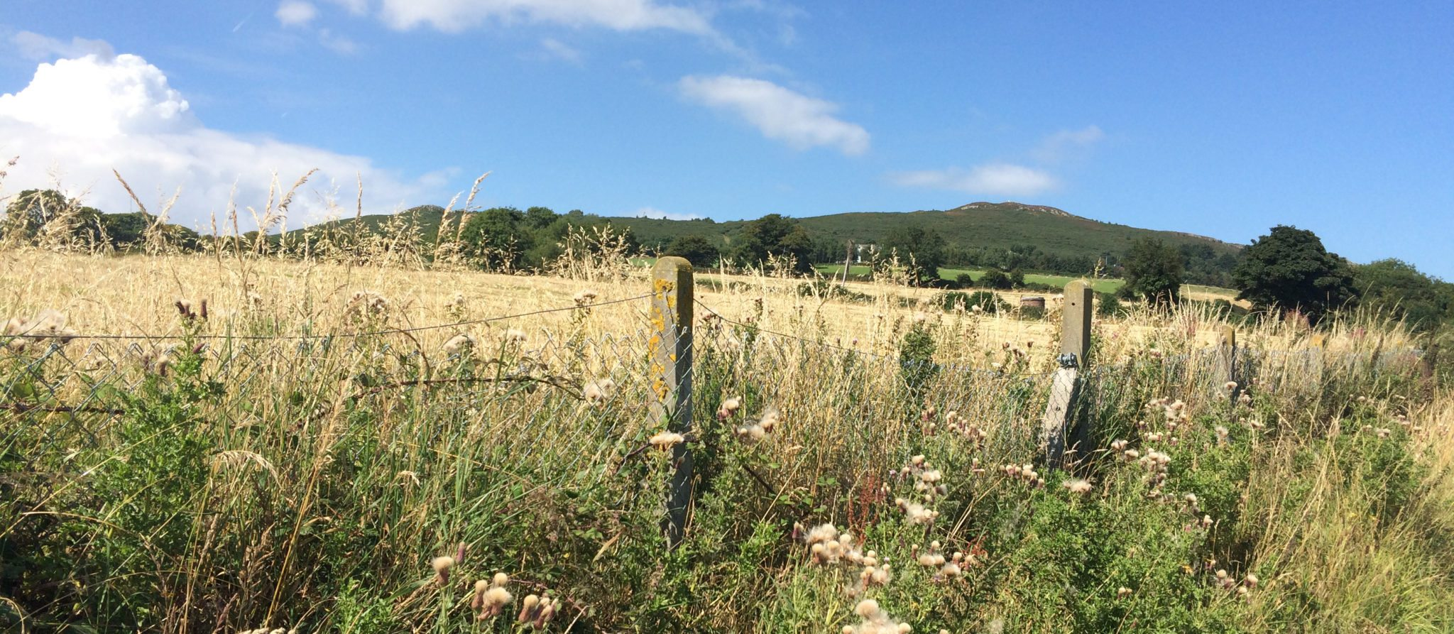
2. Spotlight on Payment for Ecosystem Services (PES)
Increase ecological training for farm advisors and ecological expertise within farm advisory services to support the provision of bespoke ecological information and expertise to farmers.
Further enable the development of integrated Payment for Ecosystems Services using new data on ecosystems and ecosystems services, as part of natural capital accounting.

Slide 10
3. Support for Integration
Develop guidelines, e.g. in the public spending code, for the inclusion of nature in decision making processes, using methodologies and data developed under natural capital accounting.
Progress the valuation of ecosystem services and assets in monetary units to enable comparisons between ecosystem accounts (SEEA-EA) and standard economic measures in the system of national accounts (SNA) and between other countries using the same methodology.
Undertake a risk-register of ecosystems in Ireland with available data, identifying data gaps for future assessments
Ensure that an indicator for biodiversity and natural capital are included in future iterations of the National Wellbeing Framework as data becomes available
Commit to annual reporting on natural capital alongside existing biodiversity data and indicators, to support closer management of the crisis in biodiversity and nature, when data is available.
Identify the department to lead and drive the adoption of natural capital accounting in policy and sectoral decision-making.
Convene an all-island conference to share experience and approaches for the development of natural capital accounting.

Slide 11
Final Remarks
The Council’s work brings together the perspectives, expertise and experience of many.
Natural capital accounting requires a collaborative and coordinated approach to be effective.
Thank you for your support and engagement with this work!

