Slide 1
Just transition in Ireland:
recent developments and the role of NESC
Niamh Garvey, Senior Policy Analyst

Slide 2
NESC is the national advisory body to the Taoiseach and the Irish Government, providing research, dialogue and advice that helps achieve Ireland’s sustainable economic, social and environmental development.
NESC Membership
The Council
Chairperson – Department of the Taoiseach
Business & Employers (3)
Irish Congress of Trade Unions (3)
Farming & Agriculture (3)
Community & Voluntary (3)
Environment (3)
Public Service (4)
Independent Nominees (8)

Slide 3
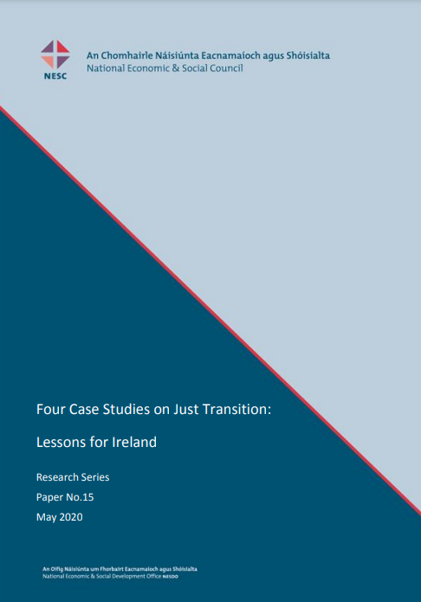
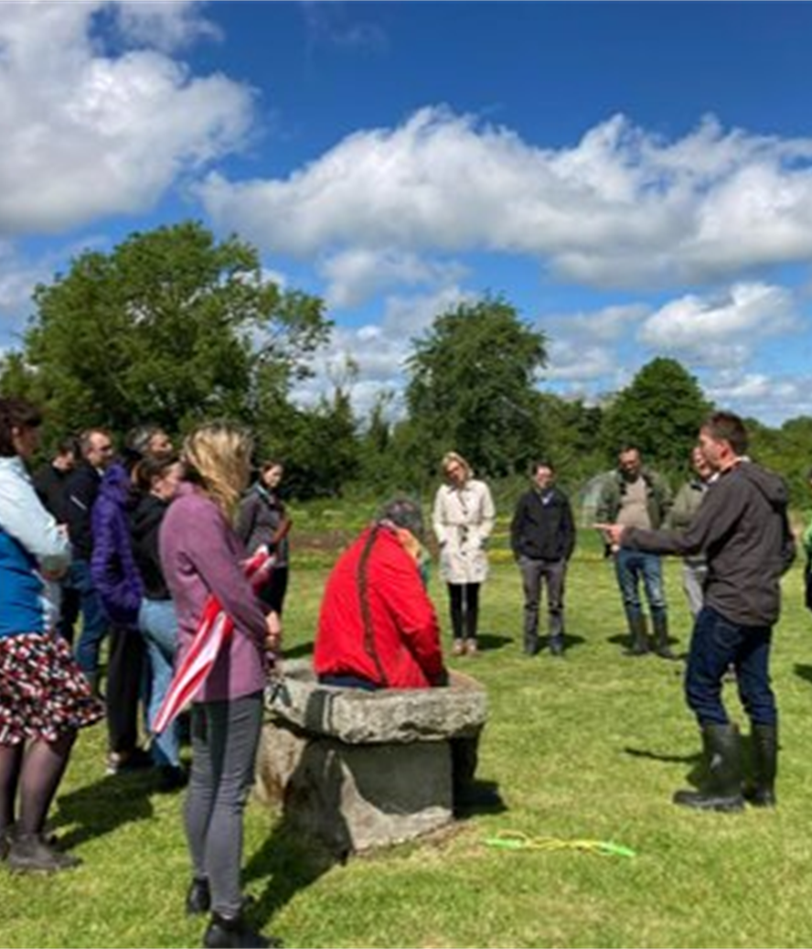
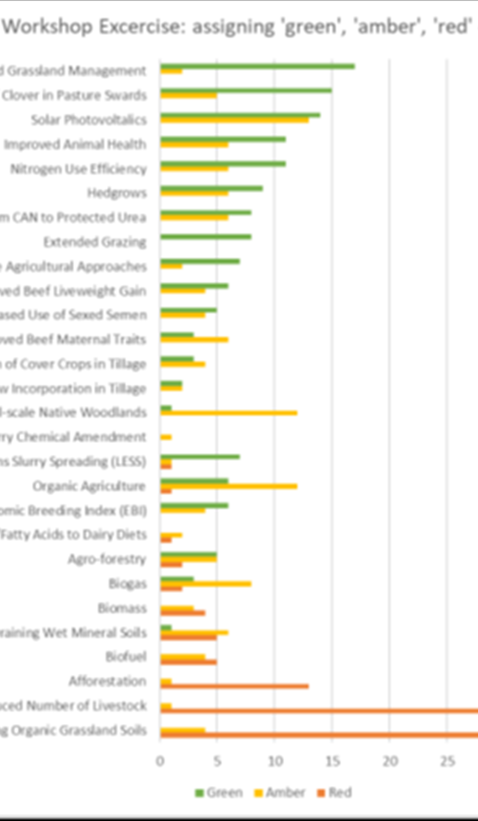
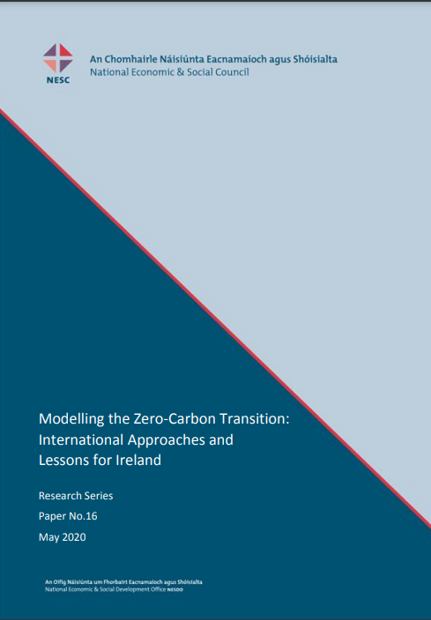
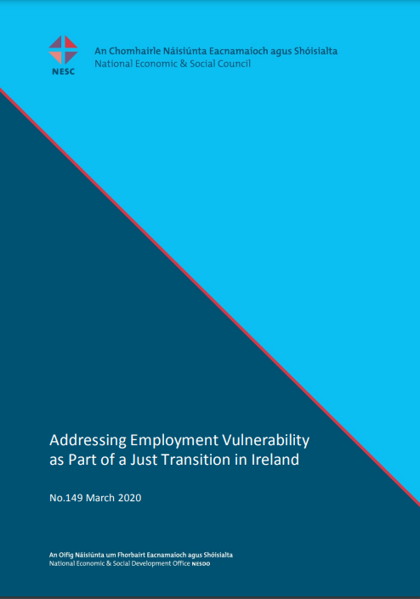
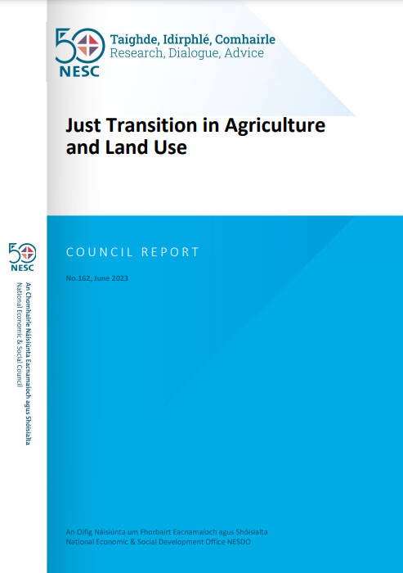
NESC work on Just Transition

Slide 4
Developments on Just Transition in Ireland
Climate Action and Low Carbon Development (Amendment) Act 2021 – just transition
Annual Climate Action Plan – just transition principles
Considerations for Carbon Budget 3 (2031-35) and Carbon Budget 4 (2036-40) (forthcoming)
Just Transition Commission (forthcoming)
Just Transition Indicators (forthcoming)

Slide 5
Some Reflections Just Transition and Adaptation
Synergies: just transition and adaptive capacity.
Just Resilience: conceptual connection between adaptation and just transition.
Indicators: just transition, adaptation, well-being.
Stakeholder engagement: procedural as well as distributive justice, effective foresight.

