Slide 1
Using systems thinking for public policy
IBSPN
March 2025

Slide 2
Contents
Brief background on NESC
Part 1:
OECD study: Redesigning Ireland’s Transport for Net Zero
The report
Methodology & tools
The result
Part 2:
NESC Energy System study

Slide 3
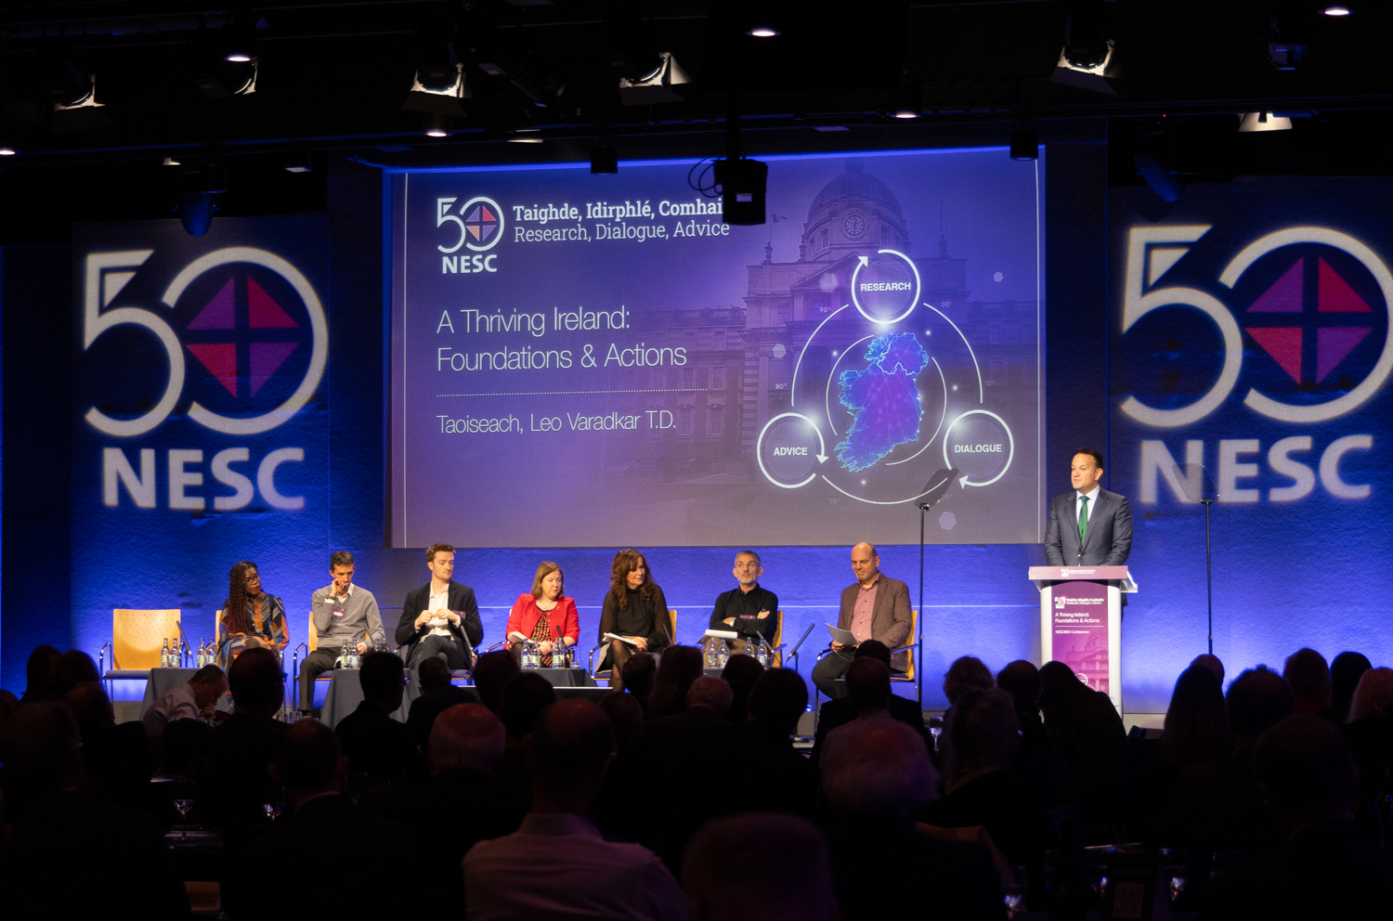
About the National Economic and Social Council
Background
Established in 1973 to provide research, dialogue and advice to the Taoiseach
Focus on strategic policy issues relating to economic, social and environmental development
Opportunity for policy system to consider strategic policy issues where there is a need for consensus
Council reports go to Government

Slide 4
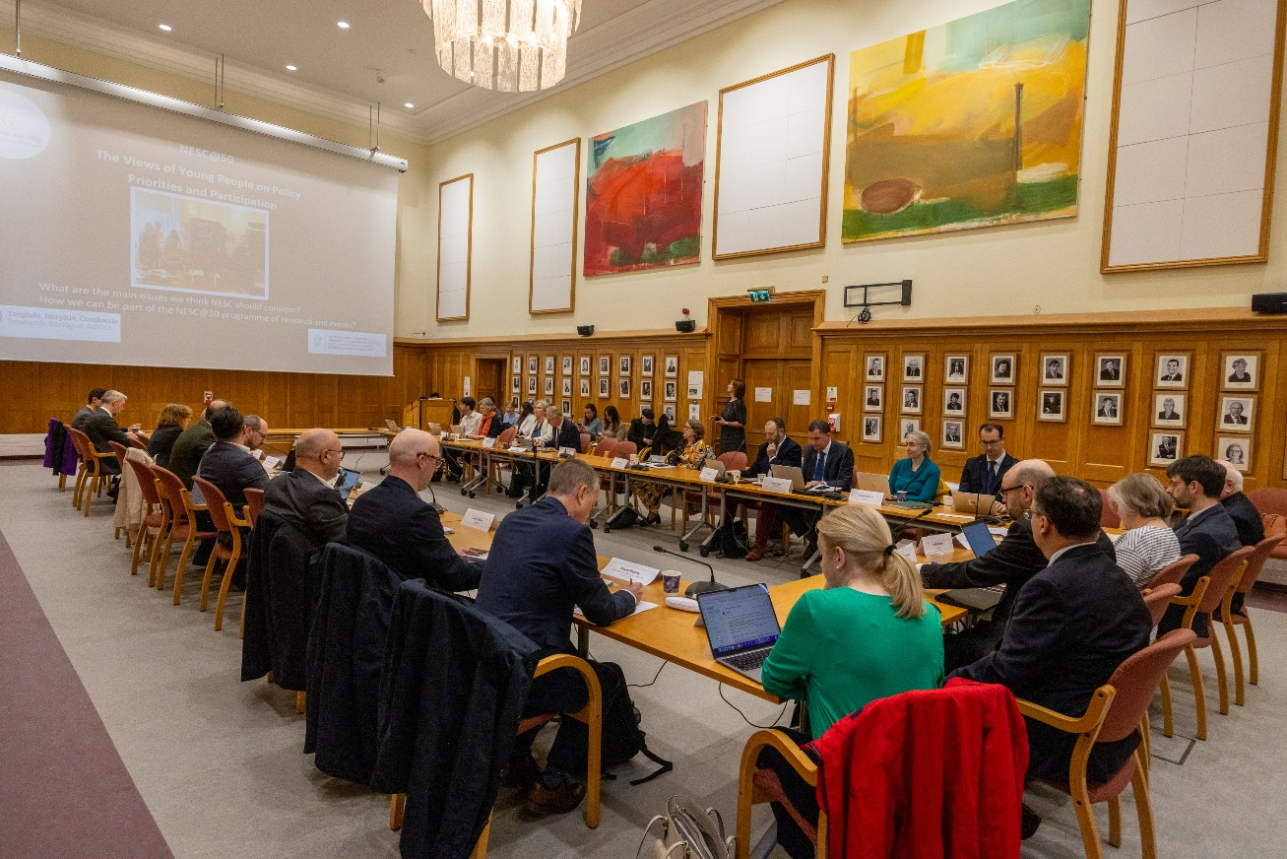
About the National Economic and Social Council
Structure & Membership
Chaired by the Department of the Taoiseach
Employers, unions, farming organisations, community and voluntary sector, and the environmental pillar
Includes the Departments of Finance, DPER, Enterprise, and Housing
Eight independent experts
Supported by Secretariat

Slide 5
Background
A bit about myself…
Economics & philosophy starting point, then environmental policy
15 years on climate – an intransigent problem, competing explanations
Exposed to systems methodology at the OECD Working Party on Climate, Investment & Development

Slide 6
Pt.1
OECD Case Study
Redesigning Ireland’s Transport for Net Zero

Slide 7
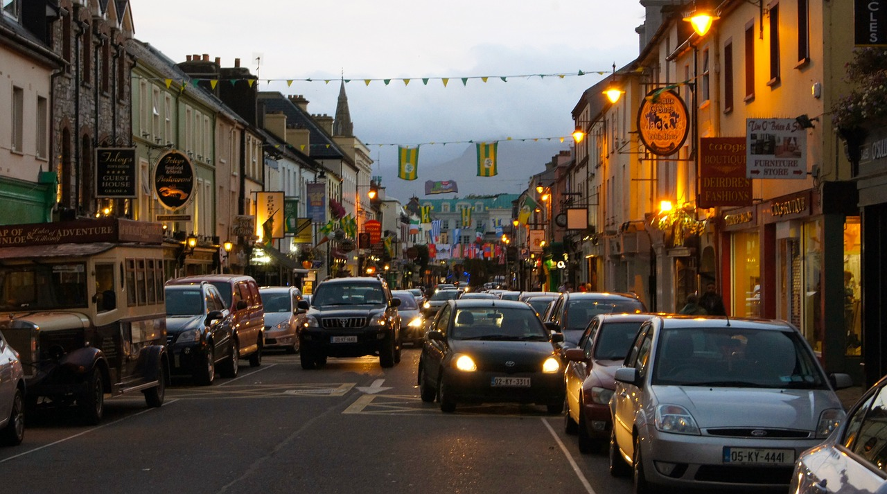
The OECD Case Study Report Preview
Ireland is a car dependent society but this can change
Huge body of work; vast literature review
Individual elements of the report were not new;
Induced demand, attractiveness trap in public transport, urban sprawl etc
BUT
Reconciled a broad array of sometimes competing evidence;
Showed a way forward

Slide 8
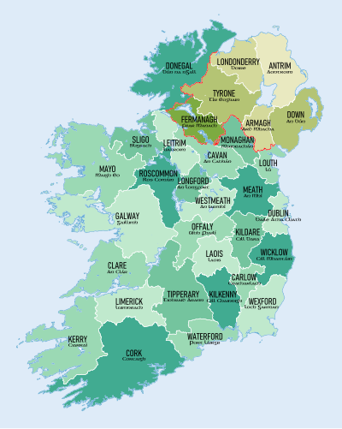
The OECD Case Study
Scope;
Passenger transport
Extensive stakeholder interviews
Case studies within the case study;
Cork, Dublin, Kildare, Sligo

Slide 9
Methodology
OECD Transformational Change for Net Zero
Envision the goal(s) and the patterns of behaviours that a properly functioning system would foster,
Understand why the current system is not achieving envisioned goals and patterns of behaviour
Prioritise and scale up the policies that can redesign systems to foster desirable patterns of behaviour and goals

Slide 10
Concept of Behaviour
Individual preferences and patterns of behaviour largely result from the system structure in which they are embedded (e.g. car-dependent systems) and the mental models (e.g. car-centric thinking) that have shaped such structure
Government policies have been fundamental to shaping current systems and have also had a major influence on prevalent mental models.
With the right policies, systems could be deliberately redesigned to promote and facilitate other choices and trigger large-scale behavioural change which is otherwise unlikely.

Slide 11
Systems tools:
Causal Loop Diagrams
Help to understand dynamic effects
Identify vicious or virtuous circles, equilibria or sticking points, bottlenecks, catch 22s etc.
Helps see existing research in a new way
Helps identify where and which interventions might be fruitful or doomed to fail

Slide 12
Systems tools: stocks and flows, and policy mapping
Tackling historic or engrained imbalances/behaviours/infrastructures
Policy mapping; following resource commitments, comparing allocation of resource and policy to stated aims/objectives

Slide 13
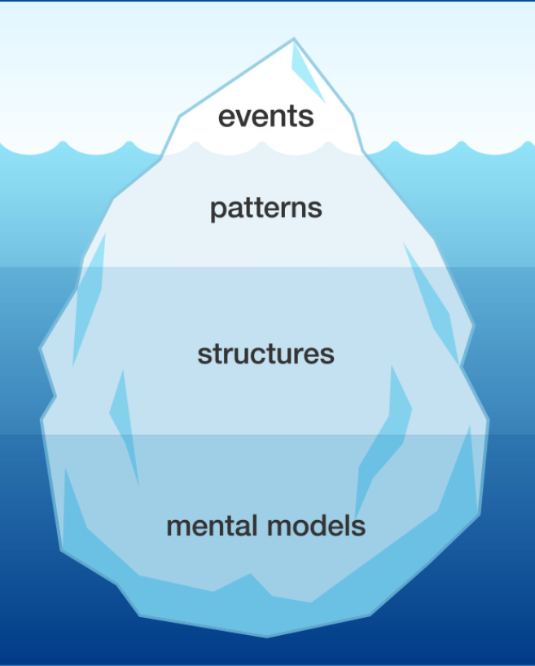
Systems tools:
Iceberg model
Events: Observable actions and phenomena;
traffic jams, pollution peaks, road fatalities, emissions
Patterns: Trends over time
Growing car ownership, longer commutes, accompanied trips
Structure: How the parts are interrelated to influence patterns
induced demand, urban sprawl etc.
Mental Models: mindsets, beliefs, feelings
Cars as status symbols, roads belong to cars etc.

Slide 14
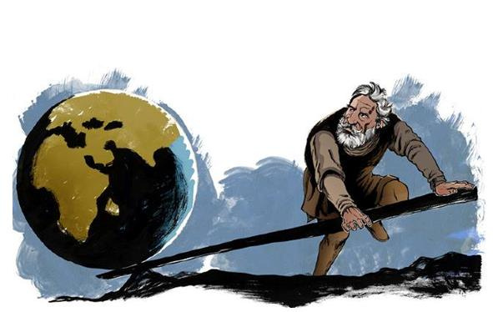
Systems tools: Leverage Points
Where on the iceberg is highest impact achieved?

Slide 15
Systems tools: Leverage Points
Models
Structures
Patterns
Events

Slide 16
Systems tools: Leverage Points
Models
Structures
Patterns
Events
Change goal from mobility to access,
From ICE vkm to all vkm
Road space reallocation

Slide 17
Systems Tools: Participative Stakeholder Engagement
The Workshop
Participative exercises
Positive vision, imagination
Listening, developing shared insights
Community of practice
Counterpoint: sequential engagement, black box reconciliation

Slide 18
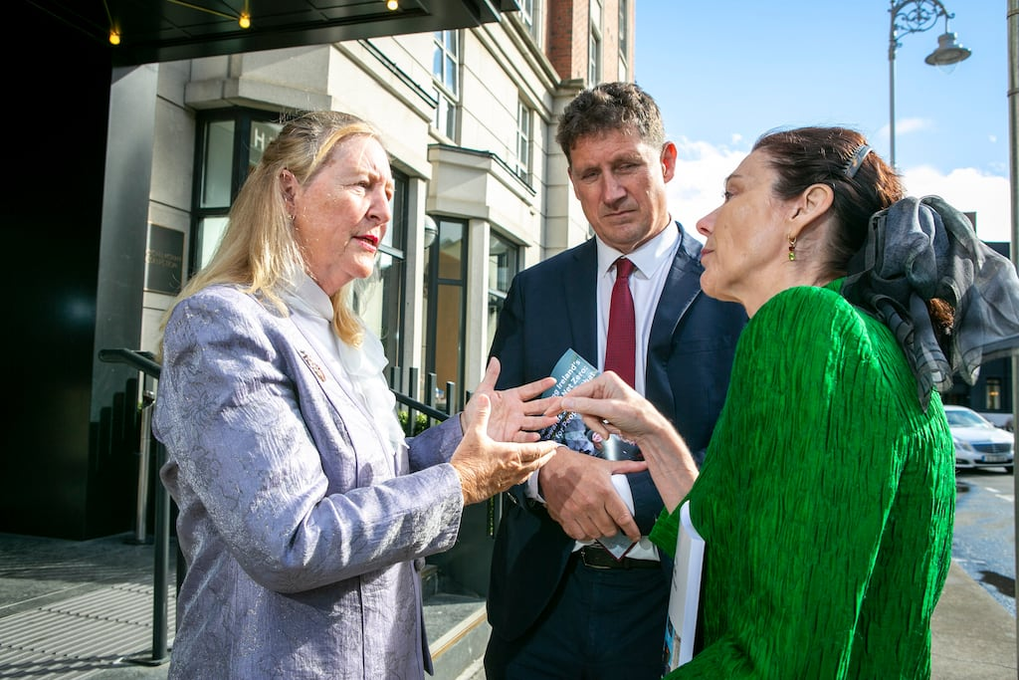
Results
High media interest
Cross party welcome for report
Approach adopted into policies and strategies
Road space reallocation, on demand shared services, communication vs car centricity
Why so successful?
Reconciled different view points
Had powerful explanations for why progress has been slow
Made a powerful case that change is possible

Slide 19
Pt.2
Energy Transition
Systems Analysis
Moving from the trilemma to the donut
[a work in progress!]

Slide 20
Contents
Scope/Aims
Envision: Developing an energy donut
Envision: Stakeholder feedback
Understand: Using the donut to map policy
Understand: Causal Loop Diagrams and stakeholder feedback
Prioritise: Identifying leverage points and redesign systems

Slide 21
Energy Systems Report: Scope/Aims
Addressing heat and electricity together
A lot happening across the sector but lack of a shared understanding therefore risks of incoherence
Develop a coherent accessible narrative on transition across the energy sector
Identify fundamental drivers and constraints to transition. Take a systems approach to identifying leverage points to accelerate progress
Develop advice for government on a coherent strategy for the sector

Slide 22
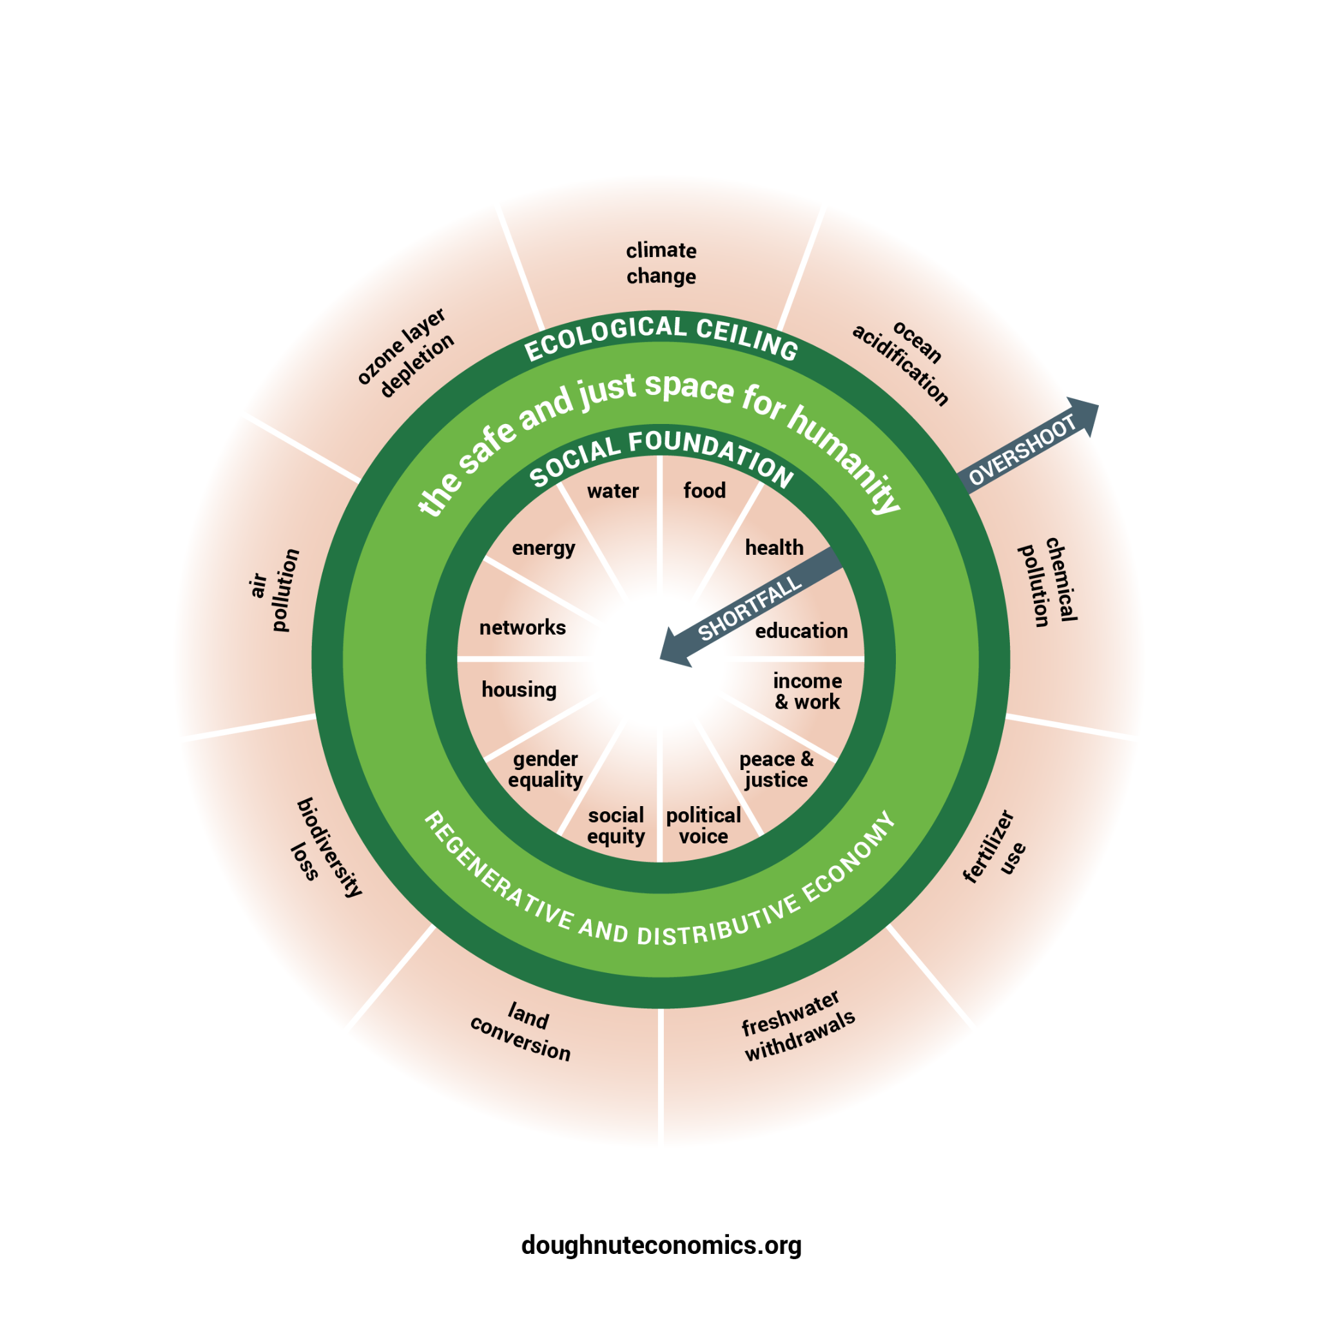
Envision: Developing an Energy Donut
The energy trilemma, of sustainability, affordability and security, doesn’t capture the complexity
Doughnut economic concept summarises more completely the complex demands we face in society
It also suggests a solution space
But is not directly applicable to sectors

Slide 23
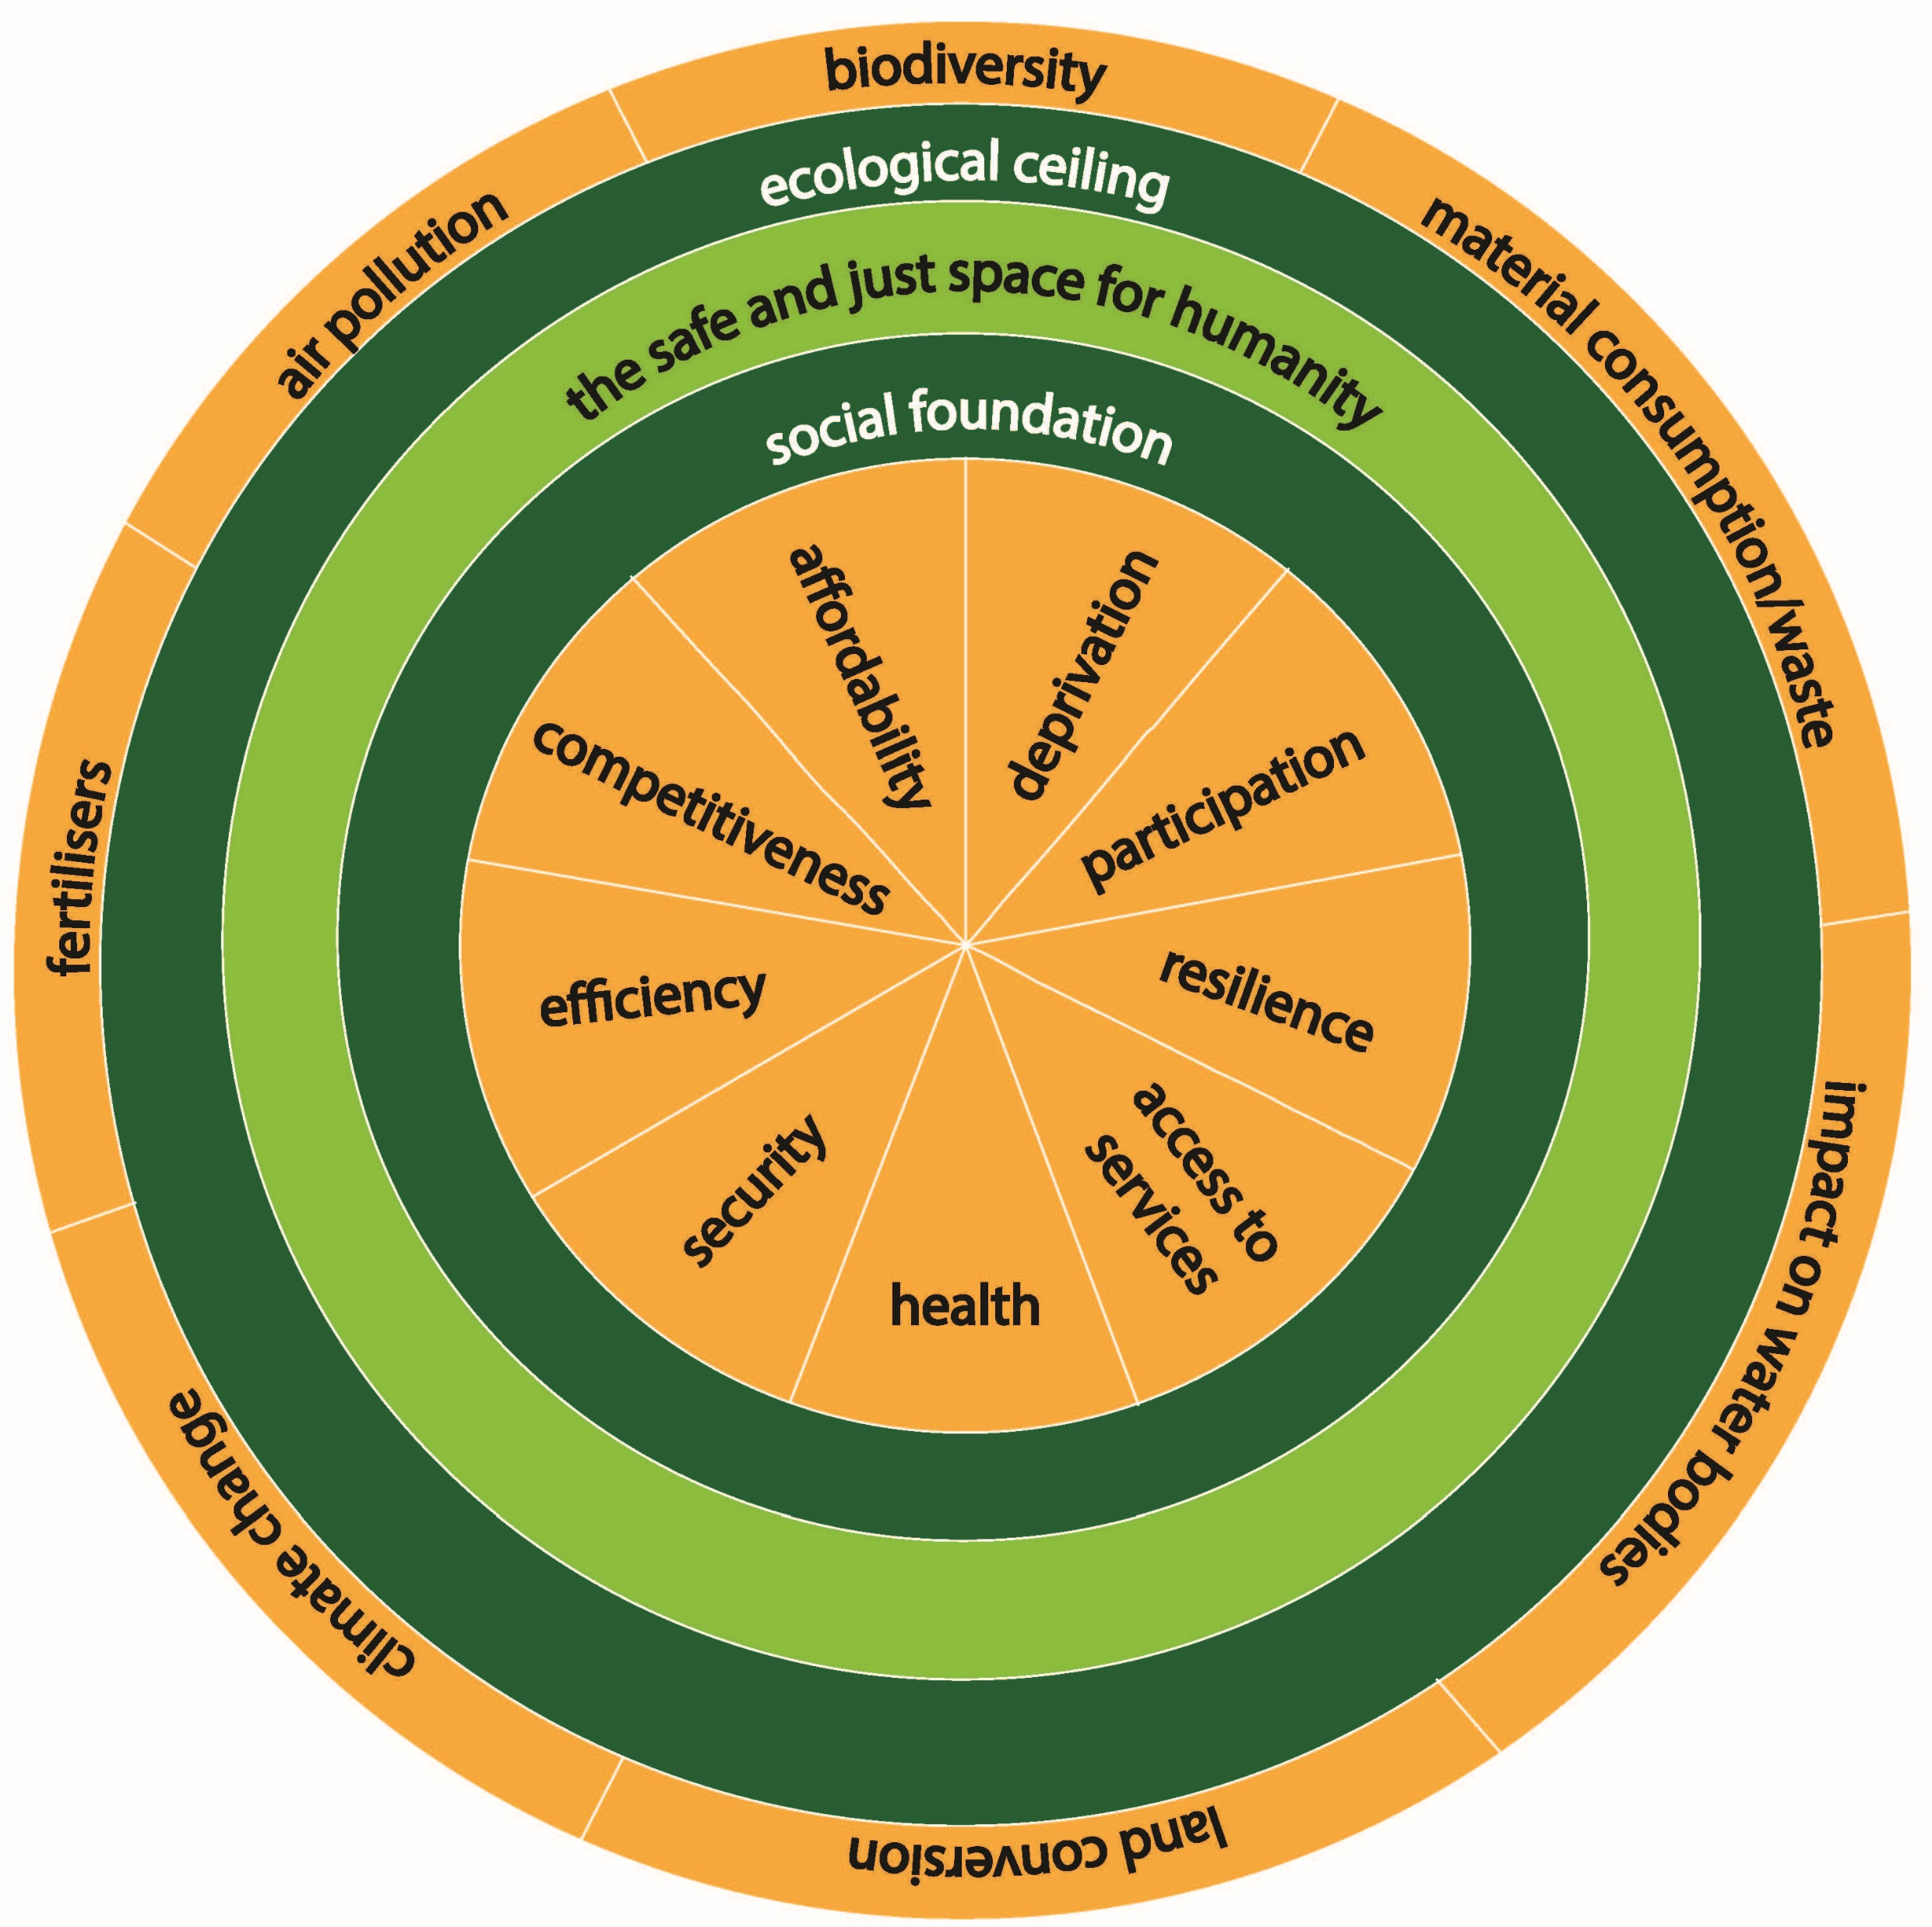
Envision: energy donut
Derived from the original doughnut
The features of energy that support the social foundation, and the ecological ceilings relevant to energy
Captures multi-faceted challenges to energy
Domestic and international dimensions
Now exploring:
Can we use this to assess progress?
Can we use this to aid decision making?

Slide 24
Envision & Understand: Nov 2024 Workshop
~ 40 stakeholders in heat and electricity, facilitated by Prof. Birgit Kopainsky, University of Bergen
Envision
Understand
What does success look like?
What are the behaviours, institutions, assets, transactions, market structures that will be current?
It’s 2050. Ireland has successfully decarbonised and had a just transition… etc.
What are the dynamic drivers and constraints on deployment of low carbon technology?
Looked at heat pumps and renewable electricity
Used causal loop diagrams

Slide 25
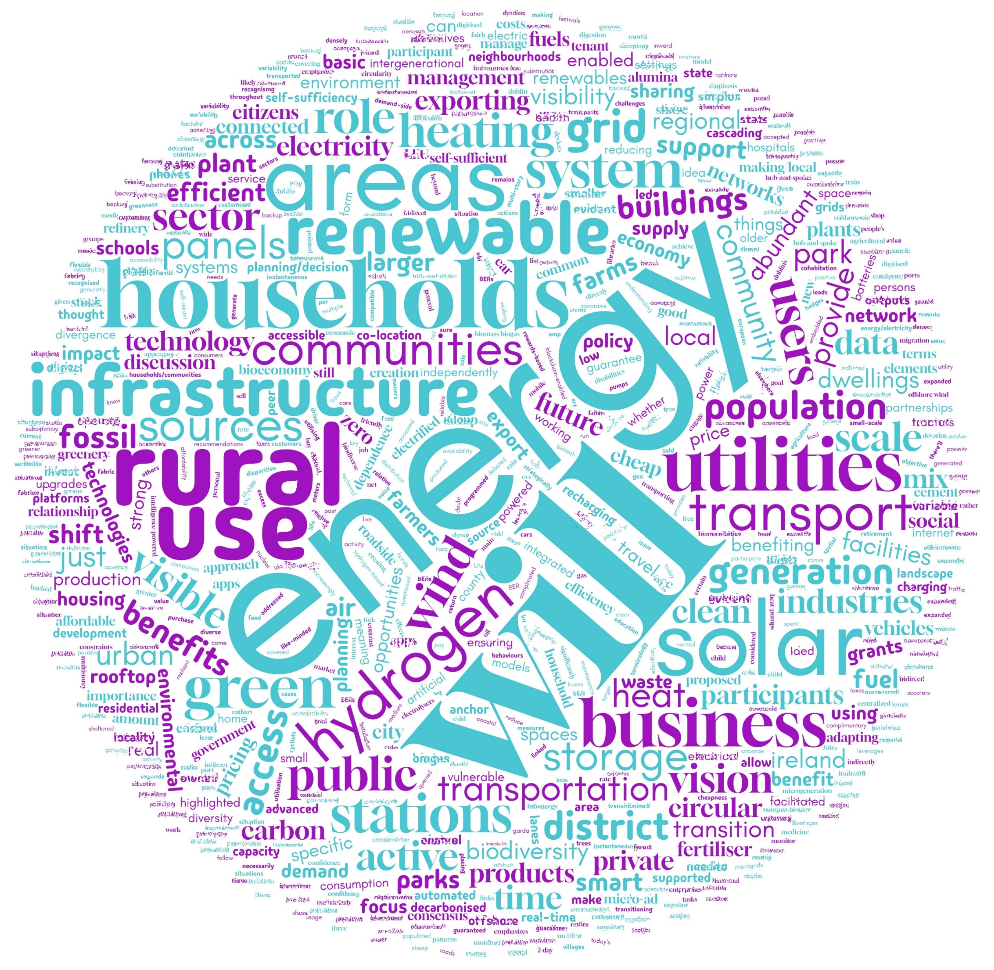
Envision: Stakeholder workshop outcome
Stakeholders saw importance in vision setting/making
Greater realisation of complexity
New insights emerged
Was possible to identify areas of convergence and divergence, themes
Didn’t shy away from tough topics, though didn’t force resolution either
A second workshop aims to take next step to have stakeholders explore solutions using systems tools.

Slide 26
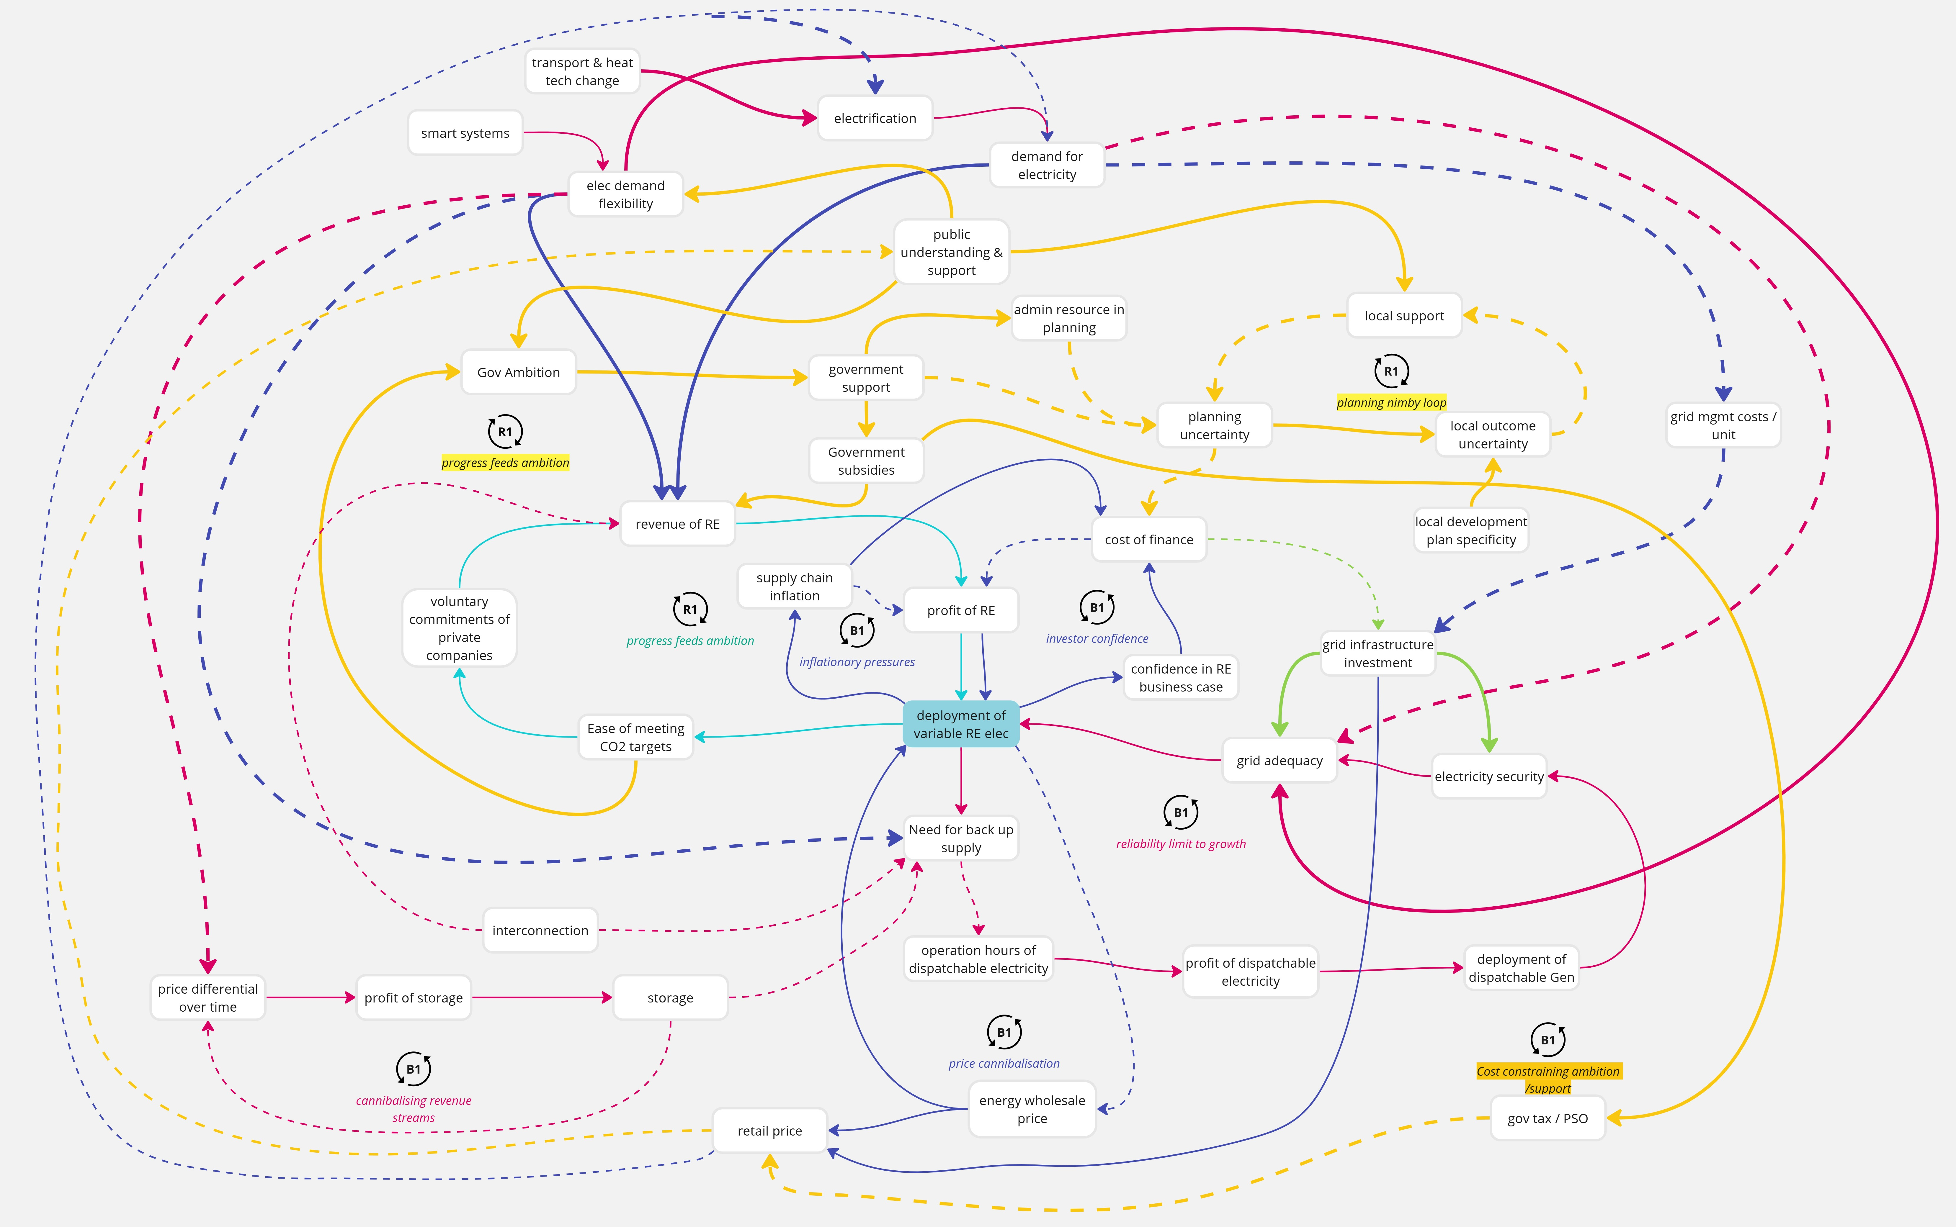
Understand:
Causal Loop Diagrams
Developed at desk for range of questions, then feedback via workshop exercise
Merits and demerits in communication…
Combines different types of information
Next step here to work on solutions / intervention points with input from 2nd stakeholder workshop

Slide 27
[Compare & Contrast]
(passenger) Transport
Heat/Power
Big legacy investments at national & household level; roads, cars
Behavioural question is how not to use existing assets
Changes can be visualised
Market structure not complex, easy to crunch numbers
Economics, behavioural science, engineering, political science, planning all relevant
Cascading / dynamic impacts
Big investment required at national and household level
Behavioural question; how to get people to make upfront investment with long payback
Changes hard to visualise
Complex market signals
Economics, behavioural science, engineering, political science, planning all relevant
Cascading / dynamic impacts

Slide 28
Thank You
 | Gemma O’Reilly | gemma.oreilly@nesc.ie
Visit us at nesc.ie

